Slide 1
Short a; consonants m, n, s, t, x
Alpha-Phonics Lesson 1 · p.3
Notes:
Grade 1, day 1 of 113. 25.0 minutes.
Segments today: WARM-UP, SOUND, BUILD, COLUMN, SHOW ME
The talk on every slide is in these notes. SAY lines are read as written — they are the routines, and a routine whose wording drifts is one the children have to re-learn. NOTE lines are for you only.

Slide 2
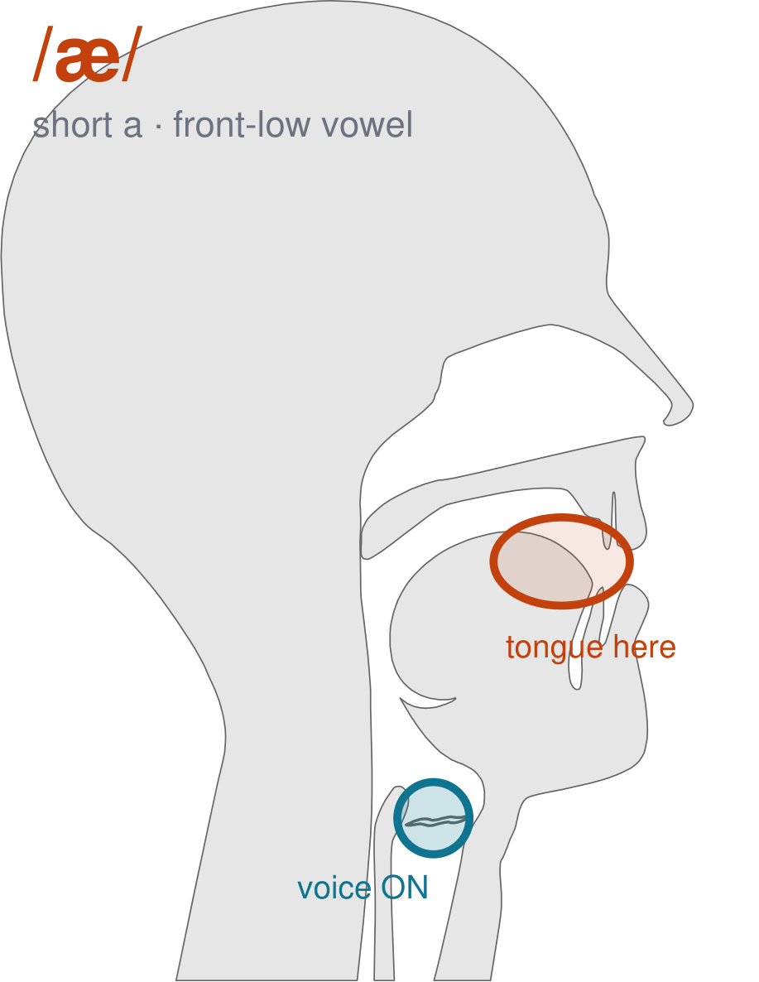
/æ/
written short a
Open your mouth WIDE and pull your lips back like a big smile. Tongue low and forward — /a/, as in 'cat'.
CHECK: Hand under your chin: this is the one where your jaw drops the most. Mirror: widest smile of the five.
Notes:
SAY: We have a new sound today. It is the sound we call short a. Before we read it, we are going to make it.
SAY: Watch my mouth. Do not say anything yet — just watch.
DO: Make the sound three times, slowly, exaggerated. Say nothing else. Let them watch your front low position.
SAY: What did you notice about my mouth?
NOTE: Take two or three answers. Steer toward the moving part — lips, tongue, teeth, air, voice. Do not correct wrong noticing; ask another child.
SAY: Open your mouth WIDE and pull your lips back like a big smile. Tongue low and forward — /a/, as in 'cat'.
SAY: Now you check it on yourself. Hand under your chin: this is the one where your jaw drops the most. Mirror: widest smile of the five.
DO: Every child does the check. Walk the room. You are looking for the check being DONE, not for the sound being perfect yet.
SAY: Say it with me. /æ/ … /æ/ … /æ/.
NOTE: Individual turns from four or five children, chosen so you hear the ones you are worried about. Give feedback on the MOUTH, not on the sound: 'your teeth were not on your lip' beats 'that was not quite right.'
NOTE: Watch for: /ɛ/ (short e). The two are neighbours; the jaw is the difference.
NOTE: This sound does not exist in Arabic, Somali, Urdu. For those children it is a new physical skill, not a reminder. Expect it to take days, and do not let the column start until the mouth can make it.
SAY: One more sound you will see today: /t/, written t. Put the tip of your tongue on the bumpy ridge just behind your top teeth. Hold the air. Now let it go — /t/. Voice off.
NOTE: Quick introduction only — /t/ gets its full lesson in a day or two. Today the children just need it in the mouth before they meet it in the column.
SAY: These letters you already know the sound of: m, n, s. Say each one as I point.
NOTE: Naming, not teaching — these sounds exist in the children's home languages. If one of them is genuinely shaky for a child, that is a warm-up item tomorrow, not a five-minute detour now.

Slide 3
a
m
am
Notes:
The slide starts blank. Click for each piece: a … m … then am.
SAY: a … then m … put them together: am.
NOTE: build it on the board beside the slide and LEAVE the pieces up. The child has to see that the whole word is made of the parts still visible next to it. Erasing the steps erases the reason.

Slide 4
a
n
an
Notes:
The slide starts blank. Click for each piece: a … n … then an.
SAY: a … then n … put them together: an.
NOTE: build it on the board beside the slide and LEAVE the pieces up. The child has to see that the whole word is made of the parts still visible next to it. Erasing the steps erases the reason.

Slide 5
a
s
as
Notes:
The slide starts blank. Click for each piece: a … s … then as.
SAY: a … then s … put them together: as.
NOTE: build it on the board beside the slide and LEAVE the pieces up. The child has to see that the whole word is made of the parts still visible next to it. Erasing the steps erases the reason.

Slide 6
a
t
at
Notes:
The slide starts blank. Click for each piece: a … t … then at.
SAY: a … then t … put them together: at.
NOTE: build it on the board beside the slide and LEAVE the pieces up. The child has to see that the whole word is made of the parts still visible next to it. Erasing the steps erases the reason.

Slide 7
a
x
ax
Notes:
The slide starts blank. Click for each piece: a … x … then ax.
SAY: a … then x … put them together: ax.
NOTE: build it on the board beside the slide and LEAVE the pieces up. The child has to see that the whole word is made of the parts still visible next to it. Erasing the steps erases the reason.

