Slide 1
Short u words
Alpha-Phonics Lesson 27 · p.41
Notes:
Grade 1, day 41 of 113. 26.9 minutes.
Segments today: WARM-UP, SOUND, BUILD, COLUMN, SHOW ME, DICTATION, CLOSE
The talk on every slide is in these notes. SAY lines are read as written — they are the routines, and a routine whose wording drifts is one the children have to re-learn. NOTE lines are for you only.

Slide 2
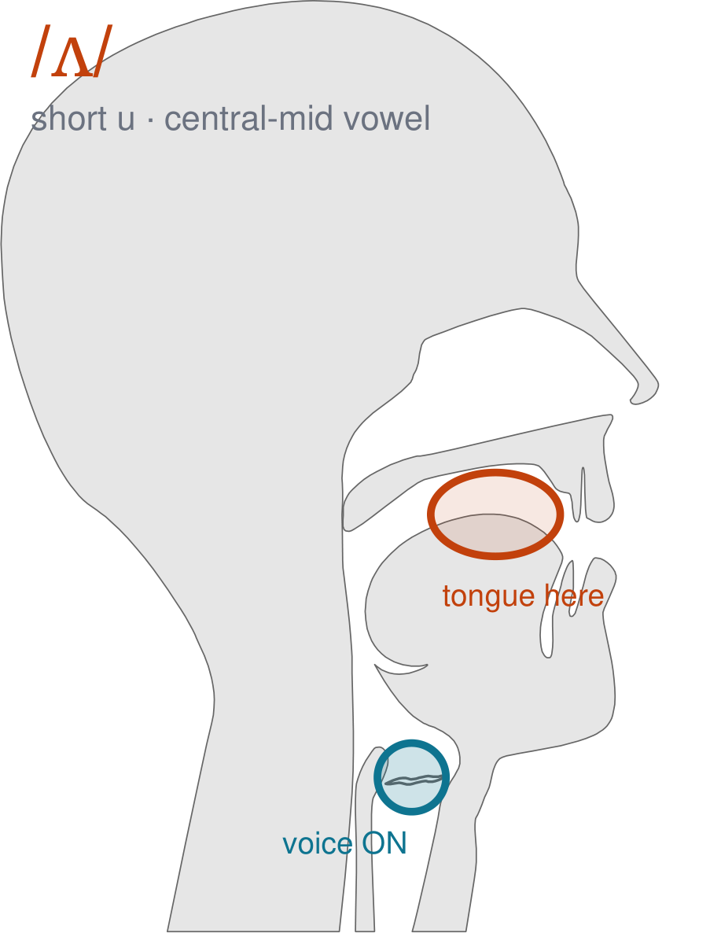
/ʌ/
written short u
Mouth relaxed and half open. Do nothing with your lips at all — no smile, no rounding. Tongue flat in the middle — /u/, as in 'cup'.
CHECK: This is the LAZIEST sound in English. If your face is doing anything, you are trying too hard.
Notes:
SAY: We have a new sound today. It is the sound we call short u. Before we read it, we are going to make it.
SAY: Watch my mouth. Do not say anything yet — just watch.
DO: Make the sound three times, slowly, exaggerated. Say nothing else. Let them watch your central mid position.
SAY: What did you notice about my mouth?
NOTE: Take two or three answers. Steer toward the moving part — lips, tongue, teeth, air, voice. Do not correct wrong noticing; ask another child.
SAY: Mouth relaxed and half open. Do nothing with your lips at all — no smile, no rounding. Tongue flat in the middle — /u/, as in 'cup'.
SAY: Now you check it on yourself. This is the LAZIEST sound in English. If your face is doing anything, you are trying too hard.
DO: Every child does the check. Walk the room. You are looking for the check being DONE, not for the sound being perfect yet.
SAY: Say it with me. /ʌ/ … /ʌ/ … /ʌ/.
NOTE: Individual turns from four or five children, chosen so you hear the ones you are worried about. Give feedback on the MOUTH, not on the sound: 'your teeth were not on your lip' beats 'that was not quite right.'
NOTE: Watch for: /ɒ/ and /ɑ/. Because it is unmarked, children reach for a stronger vowel.
NOTE: This sound does not exist in Arabic, Somali, Urdu. For those children it is a new physical skill, not a reminder. Expect it to take days, and do not let the column start until the mouth can make it.

Slide 3
cub bud bug cull
bun dub dud dug
dull fun hub hug
Notes:
The slide starts blank. One click per row.
SAY: Down the first column. My pointer, your voice.
SAY: Now across the rows.
NOTE: down a column can be recited from memory; across cannot. A child who was strong going down and falls apart going across was reciting. That is what this step is for — the same reason a Qaida is drilled down, then across, then random.
SAY: Now I am going to jump around. Watch the pointer.
NOTE: anything missed here goes on tomorrow's warm-up.

Slide 4
gull gun pub Jug
hull pun rub lug
run sub full sun
Notes:
The slide starts blank. One click per row.
SAY: Down the first column. My pointer, your voice.
SAY: Now across the rows.
NOTE: down a column can be recited from memory; across cannot. A child who was strong going down and falls apart going across was reciting. That is what this step is for — the same reason a Qaida is drilled down, then across, then random.
SAY: Now I am going to jump around. Watch the pointer.
NOTE: anything missed here goes on tomorrow's warm-up.

Slide 5
tub rug pull tug
up us cup bus
but lux buzz pup
Notes:
The slide starts blank. One click per row.
SAY: Down the first column. My pointer, your voice.
SAY: Now across the rows.
NOTE: down a column can be recited from memory; across cannot. A child who was strong going down and falls apart going across was reciting. That is what this step is for — the same reason a Qaida is drilled down, then across, then random.
SAY: Now I am going to jump around. Watch the pointer.
NOTE: anything missed here goes on tomorrow's warm-up.

Slide 6
Gus cut fuzz hut
fuss nut
Notes:
The slide starts blank. One click per row.
SAY: Down the first column. My pointer, your voice.
SAY: Now across the rows.
NOTE: down a column can be recited from memory; across cannot. A child who was strong going down and falls apart going across was reciting. That is what this step is for — the same reason a Qaida is drilled down, then across, then random.
SAY: Now I am going to jump around. Watch the pointer.
NOTE: anything missed here goes on tomorrow's warm-up.

Slide 7
hut
fuss
nut
Notes:
The slide starts blank. Click ONE word per child as they come to you — the queue should not be able to rehearse the next one.
SAY: Before you go, three words, on your own.
NOTE: one child at a time as they line up. Mark 3, 2, or fewer. Two or fewer starts tomorrow's warm-up group. That is the whole reason for recording it — do not skip it, and do not make it public.

