Slide 1
a as in all; sentences
Alpha-Phonics Lesson 40 · p.56
Notes:
Grade 1, day 53 of 113. 30.4 minutes.
Segments today: WARM-UP, SOUND, BUILD, COLUMN, SHOW ME, DICTATION, SENTENCES, CLOSE
The talk on every slide is in these notes. SAY lines are read as written — they are the routines, and a routine whose wording drifts is one the children have to re-learn. NOTE lines are for you only.

Slide 2
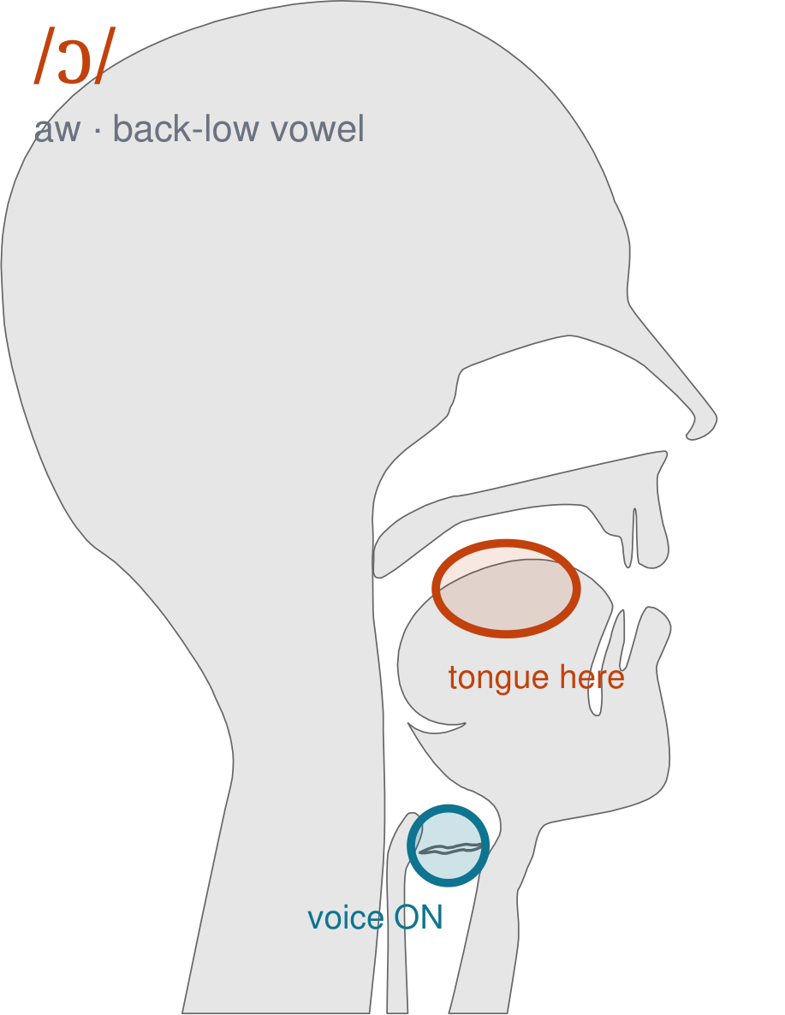
/ɔ/
written aw
Open your mouth like short o, then push your lips forward into a round shape and hold it — aww, as in 'all' and 'saw'.
CHECK: Mirror: wide open AND round lips at the same time. Short o is open with flat lips; this one is open with round lips.
Notes:
SAY: We have a new sound today. It is written aw. Before we read it, we are going to make it.
SAY: Watch my mouth. Do not say anything yet — just watch.
DO: Make the sound three times, slowly, exaggerated. Say nothing else. Let them watch your back low position.
SAY: What did you notice about my mouth?
NOTE: Take two or three answers. Steer toward the moving part — lips, tongue, teeth, air, voice. Do not correct wrong noticing; ask another child.
SAY: Open your mouth like short o, then push your lips forward into a round shape and hold it — aww, as in 'all' and 'saw'.
SAY: Now you check it on yourself. Mirror: wide open AND round lips at the same time. Short o is open with flat lips; this one is open with round lips.
DO: Every child does the check. Walk the room. You are looking for the check being DONE, not for the sound being perfect yet.
SAY: Say it with me. /ɔ/ … /ɔ/ … /ɔ/.
NOTE: Individual turns from four or five children, chosen so you hear the ones you are worried about. Give feedback on the MOUTH, not on the sound: 'your teeth were not on your lip' beats 'that was not quite right.'
NOTE: Watch for: Short o. In much of American English 'cot' and 'caught' are the same word — do not fight your own accent. Teach the spelling and accept the vowel your class actually says.
NOTE: This sound does not exist in Arabic. For those children it is a new physical skill, not a reminder. Expect it to take days, and do not let the column start until the mouth can make it.

Slide 3
all Al Cal call
gal gall Hal hall
pal pall cal's tall
Notes:
The slide starts blank. One click per row.
SAY: Down the first column. My pointer, your voice.
SAY: Now across the rows.
NOTE: down a column can be recited from memory; across cannot. A child who was strong going down and falls apart going across was reciting. That is what this step is for — the same reason a Qaida is drilled down, then across, then random.
SAY: Now I am going to jump around. Watch the pointer.
NOTE: anything missed here goes on tomorrow's warm-up.

Slide 4
fall ball wall mall
Notes:
The slide starts blank. One click per row.
SAY: Down the first column. My pointer, your voice.
SAY: Now across the rows.
NOTE: down a column can be recited from memory; across cannot. A child who was strong going down and falls apart going across was reciting. That is what this step is for — the same reason a Qaida is drilled down, then across, then random.
SAY: Now I am going to jump around. Watch the pointer.
NOTE: anything missed here goes on tomorrow's warm-up.

Slide 5
Cal's pal Tim is tall.
Notes:
The slide starts blank — click when the class is silent and looking, not before.
SAY: Read it in your head first. Put your finger up when you have it.
NOTE: wait for most fingers before calling on anyone. Silent-first is what makes this reading rather than listening.
SAY: Together: Cal's pal Tim is tall.
NOTE: then two or three individual readers — never round the class in seating order.

Slide 6
Did Hal fall?
Notes:
The slide starts blank — click when the class is silent and looking, not before.
SAY: Read it in your head first. Put your finger up when you have it.
NOTE: wait for most fingers before calling on anyone. Silent-first is what makes this reading rather than listening.
SAY: Together: Did Hal fall?
NOTE: then two or three individual readers — never round the class in seating order.

Slide 7
Cal has the ball.
Notes:
The slide starts blank — click when the class is silent and looking, not before.
SAY: Read it in your head first. Put your finger up when you have it.
NOTE: wait for most fingers before calling on anyone. Silent-first is what makes this reading rather than listening.
SAY: Together: Cal has the ball.
NOTE: then two or three individual readers — never round the class in seating order.

Slide 8
Cal hit the ball with the bat.
Notes:
The slide starts blank — click when the class is silent and looking, not before.
SAY: Read it in your head first. Put your finger up when you have it.
NOTE: wait for most fingers before calling on anyone. Silent-first is what makes this reading rather than listening.
SAY: Together: Cal hit the ball with the bat.
NOTE: then two or three individual readers — never round the class in seating order.

Slide 9
Philip sat on the wall.
Notes:
The slide starts blank — click when the class is silent and looking, not before.
SAY: Read it in your head first. Put your finger up when you have it.
NOTE: wait for most fingers before calling on anyone. Silent-first is what makes this reading rather than listening.
SAY: Together: Philip sat on the wall.
NOTE: then two or three individual readers — never round the class in seating order.

Slide 10
His jacket is in the hall.
Notes:
The slide starts blank — click when the class is silent and looking, not before.
SAY: Read it in your head first. Put your finger up when you have it.
NOTE: wait for most fingers before calling on anyone. Silent-first is what makes this reading rather than listening.
SAY: Together: His jacket is in the hall.
NOTE: then two or three individual readers — never round the class in seating order.

Slide 11
ball
wall
mall
Notes:
The slide starts blank. Click ONE word per child as they come to you — the queue should not be able to rehearse the next one.
SAY: Before you go, three words, on your own.
NOTE: one child at a time as they line up. Mark 3, 2, or fewer. Two or fewer starts tomorrow's warm-up group. That is the whole reason for recording it — do not skip it, and do not make it public.

