Slide 1
Consonant blend ng; ing words
Alpha-Phonics Lesson 41 · p.57–58
Notes:
Grade 1, day 54 of 113. 30.4 minutes.
Segments today: WARM-UP, SOUND, BUILD, COLUMN, SHOW ME, DICTATION, SENTENCES, CLOSE
The talk on every slide is in these notes. SAY lines are read as written — they are the routines, and a routine whose wording drifts is one the children have to re-learn. NOTE lines are for you only.

Slide 2
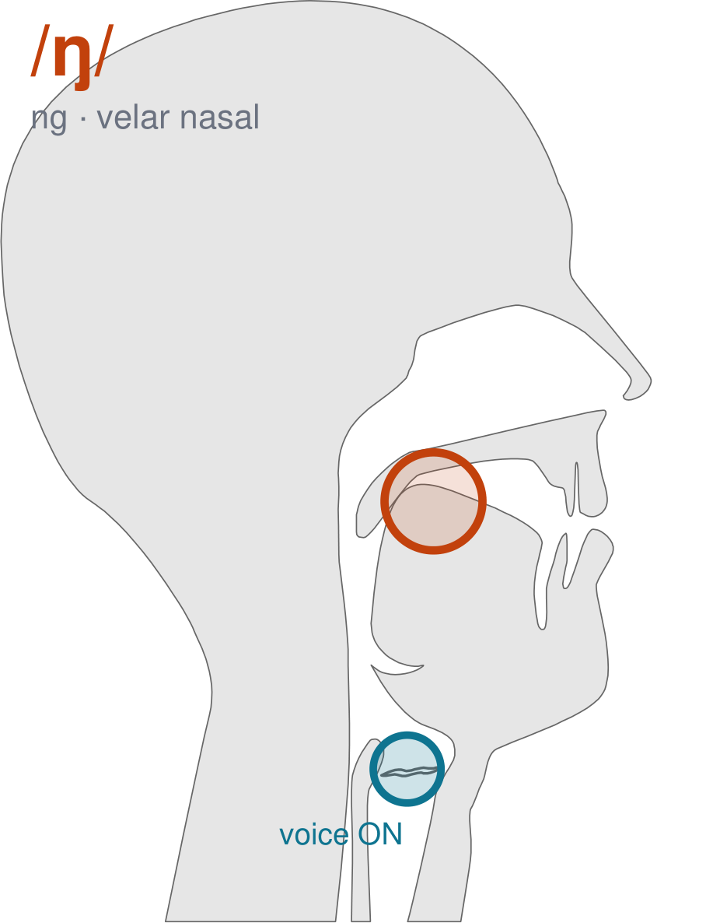
/ŋ/
written ng
The BACK of your tongue goes up to the back of the roof and stays. The sound comes out of your nose — ng. Your tongue tip never touches anything.
CHECK: Say 'sing' and freeze on the last sound. Feel where your tongue is: at the back, not the front.
Notes:
SAY: We have a new sound today. It is written ng. Before we read it, we are going to make it.
SAY: Watch my mouth. Do not say anything yet — just watch.
DO: Make the sound three times, slowly, exaggerated. Say nothing else. Let them watch your velar position.
SAY: What did you notice about my mouth?
NOTE: Take two or three answers. Steer toward the moving part — lips, tongue, teeth, air, voice. Do not correct wrong noticing; ask another child.
SAY: The BACK of your tongue goes up to the back of the roof and stays. The sound comes out of your nose — ng. Your tongue tip never touches anything.
SAY: Now you check it on yourself. Say 'sing' and freeze on the last sound. Feel where your tongue is: at the back, not the front.
DO: Every child does the check. Walk the room. You are looking for the check being DONE, not for the sound being perfect yet.
SAY: Say it with me. /ŋ/ … /ŋ/ … /ŋ/.
NOTE: Individual turns from four or five children, chosen so you hear the ones you are worried about. Give feedback on the MOUTH, not on the sound: 'your teeth were not on your lip' beats 'that was not quite right.'
NOTE: Watch for: Children say 'sin' or 'sing-g'. Neither has the tongue parked at the back.
NOTE: This sound does not exist in Arabic, Somali. For those children it is a new physical skill, not a reminder. Expect it to take days, and do not let the column start until the mouth can make it.

Slide 3
sang song rang sung
king sing gang Hong
Kong bang pang ding
Notes:
The slide starts blank. One click per row.
SAY: Down the first column. My pointer, your voice.
SAY: Now across the rows.
NOTE: down a column can be recited from memory; across cannot. A child who was strong going down and falls apart going across was reciting. That is what this step is for — the same reason a Qaida is drilled down, then across, then random.
SAY: Now I am going to jump around. Watch the pointer.
NOTE: anything missed here goes on tomorrow's warm-up.

Slide 4
ping pong wing hung
gong lung long rung
ing Washington dabbing robbing
Notes:
The slide starts blank. One click per row.
SAY: Down the first column. My pointer, your voice.
SAY: Now across the rows.
NOTE: down a column can be recited from memory; across cannot. A child who was strong going down and falls apart going across was reciting. That is what this step is for — the same reason a Qaida is drilled down, then across, then random.
SAY: Now I am going to jump around. Watch the pointer.
NOTE: anything missed here goes on tomorrow's warm-up.

Slide 5
rubbing packing picking locking
rocking bidding kidding digging
rigging calling falling selling
Notes:
The slide starts blank. One click per row.
SAY: Down the first column. My pointer, your voice.
SAY: Now across the rows.
NOTE: down a column can be recited from memory; across cannot. A child who was strong going down and falls apart going across was reciting. That is what this step is for — the same reason a Qaida is drilled down, then across, then random.
SAY: Now I am going to jump around. Watch the pointer.
NOTE: anything missed here goes on tomorrow's warm-up.

Slide 6
yelling chilling willing banging
hanging ring ringing singing
sunning napping tapping chipping
Notes:
The slide starts blank. One click per row.
SAY: Down the first column. My pointer, your voice.
SAY: Now across the rows.
NOTE: down a column can be recited from memory; across cannot. A child who was strong going down and falls apart going across was reciting. That is what this step is for — the same reason a Qaida is drilled down, then across, then random.
SAY: Now I am going to jump around. Watch the pointer.
NOTE: anything missed here goes on tomorrow's warm-up.

Slide 7
chopping shipping shopping fishing
wishing washing rushing passing
fitting quitting
Notes:
The slide starts blank. One click per row.
SAY: Down the first column. My pointer, your voice.
SAY: Now across the rows.
NOTE: down a column can be recited from memory; across cannot. A child who was strong going down and falls apart going across was reciting. That is what this step is for — the same reason a Qaida is drilled down, then across, then random.
SAY: Now I am going to jump around. Watch the pointer.
NOTE: anything missed here goes on tomorrow's warm-up.

Slide 8
Deb sang a song.
Notes:
The slide starts blank — click when the class is silent and looking, not before.
SAY: Read it in your head first. Put your finger up when you have it.
NOTE: wait for most fingers before calling on anyone. Silent-first is what makes this reading rather than listening.
SAY: Together: Deb sang a song.
NOTE: then two or three individual readers — never round the class in seating order.

Slide 9
Ron rang the bell.
Notes:
The slide starts blank — click when the class is silent and looking, not before.
SAY: Read it in your head first. Put your finger up when you have it.
NOTE: wait for most fingers before calling on anyone. Silent-first is what makes this reading rather than listening.
SAY: Together: Ron rang the bell.
NOTE: then two or three individual readers — never round the class in seating order.

Slide 10
The song was sung.
Notes:
The slide starts blank — click when the class is silent and looking, not before.
SAY: Read it in your head first. Put your finger up when you have it.
NOTE: wait for most fingers before calling on anyone. Silent-first is what makes this reading rather than listening.
SAY: Together: The song was sung.
NOTE: then two or three individual readers — never round the class in seating order.

Slide 11
The king can sing.
Notes:
The slide starts blank — click when the class is silent and looking, not before.
SAY: Read it in your head first. Put your finger up when you have it.
NOTE: wait for most fingers before calling on anyone. Silent-first is what makes this reading rather than listening.
SAY: Together: The king can sing.
NOTE: then two or three individual readers — never round the class in seating order.

Slide 12
The gang sang.
Notes:
The slide starts blank — click when the class is silent and looking, not before.
SAY: Read it in your head first. Put your finger up when you have it.
NOTE: wait for most fingers before calling on anyone. Silent-first is what makes this reading rather than listening.
SAY: Together: The gang sang.
NOTE: then two or three individual readers — never round the class in seating order.

Slide 13
Tim is in Hong Kong.
Notes:
The slide starts blank — click when the class is silent and looking, not before.
SAY: Read it in your head first. Put your finger up when you have it.
NOTE: wait for most fingers before calling on anyone. Silent-first is what makes this reading rather than listening.
SAY: Together: Tim is in Hong Kong.
NOTE: then two or three individual readers — never round the class in seating order.

Slide 14
passing
fitting
quitting
Notes:
The slide starts blank. Click ONE word per child as they come to you — the queue should not be able to rehearse the next one.
SAY: Before you go, three words, on your own.
NOTE: one child at a time as they line up. Mark 3, 2, or fewer. Two or fewer starts tomorrow's warm-up group. That is the whole reason for recording it — do not skip it, and do not make it public.

