Slide 1
Final syllable er; er words and sentences
Alpha-Phonics Lesson 45 · p.62
Notes:
Grade 1, day 58 of 113. 30.4 minutes.
Segments today: WARM-UP, SOUND, BUILD, COLUMN, SHOW ME, DICTATION, SENTENCES, CLOSE
The talk on every slide is in these notes. SAY lines are read as written — they are the routines, and a routine whose wording drifts is one the children have to re-learn. NOTE lines are for you only.

Slide 2
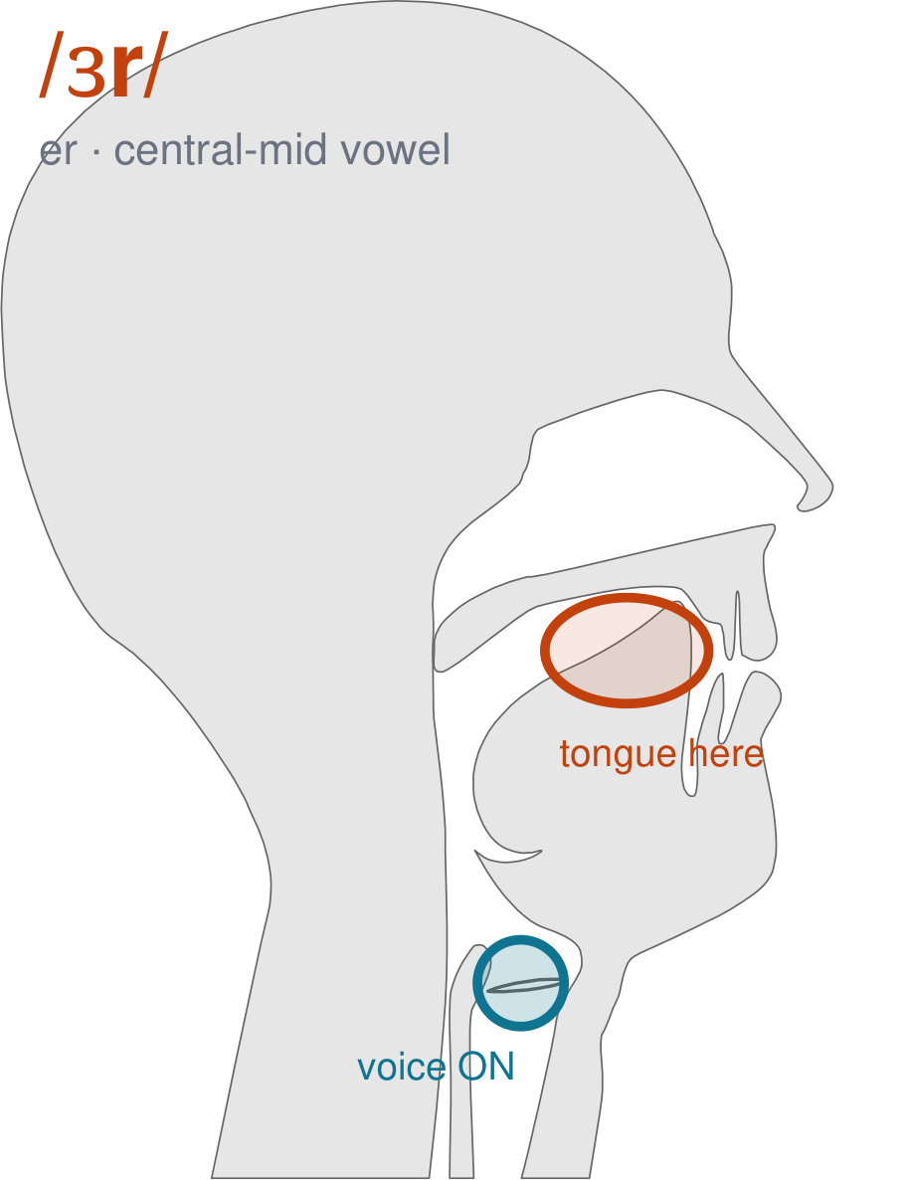
/ɜr/
written er
Say the sound r and hold it — that IS the vowel. Your tongue bunches up in the middle of your mouth and the tip curls back, and it touches nothing at all. 'her', 'bird', 'turn' and 'burn' all have it.
CHECK: Hold the sound and look in the mirror: your tongue is not touching your teeth or the roof. Now say 'uh', then 'er', and feel your tongue pull back and bunch up.
Notes:
SAY: We have a new sound today. It is written er. Before we read it, we are going to make it.
SAY: Watch my mouth. Do not say anything yet — just watch.
DO: Make the sound three times, slowly, exaggerated. Say nothing else. Let them watch your central mid position.
SAY: What did you notice about my mouth?
NOTE: Take two or three answers. Steer toward the moving part — lips, tongue, teeth, air, voice. Do not correct wrong noticing; ask another child.
SAY: Say the sound r and hold it — that IS the vowel. Your tongue bunches up in the middle of your mouth and the tip curls back, and it touches nothing at all. 'her', 'bird', 'turn' and 'burn' all have it.
SAY: Now you check it on yourself. Hold the sound and look in the mirror: your tongue is not touching your teeth or the roof. Now say 'uh', then 'er', and feel your tongue pull back and bunch up.
DO: Every child does the check. Walk the room. You are looking for the check being DONE, not for the sound being perfect yet.
SAY: Say it with me. /ɜr/ … /ɜr/ … /ɜr/.
NOTE: Individual turns from four or five children, chosen so you hear the ones you are worried about. Give feedback on the MOUTH, not on the sound: 'your teeth were not on your lip' beats 'that was not quite right.'
NOTE: Watch for: A rolled or tapped r stuck on after a vowel — 'bird' as 'bi-rd'. Arabic, Somali and Urdu all tap or roll their r. In English there is nothing to tap: the r IS the vowel, and it is one long smooth sound.
NOTE: This sound does not exist in Somali, Arabic, Urdu. For those children it is a new physical skill, not a reminder. Expect it to take days, and do not let the column start until the mouth can make it.

Slide 3
her letter better hunter
lender sender butter tender
chatter ger bigger winter
Notes:
The slide starts blank. One click per row.
SAY: Down the first column. My pointer, your voice.
SAY: Now across the rows.
NOTE: down a column can be recited from memory; across cannot. A child who was strong going down and falls apart going across was reciting. That is what this step is for — the same reason a Qaida is drilled down, then across, then random.
SAY: Now I am going to jump around. Watch the pointer.
NOTE: anything missed here goes on tomorrow's warm-up.

Slide 4
sister Summer
Notes:
The slide starts blank. One click per row.
SAY: Down the first column. My pointer, your voice.
SAY: Now across the rows.
NOTE: down a column can be recited from memory; across cannot. A child who was strong going down and falls apart going across was reciting. That is what this step is for — the same reason a Qaida is drilled down, then across, then random.
SAY: Now I am going to jump around. Watch the pointer.
NOTE: anything missed here goes on tomorrow's warm-up.

Slide 5
Butter is better.
Notes:
The slide starts blank — click when the class is silent and looking, not before.
SAY: Read it in your head first. Put your finger up when you have it.
NOTE: wait for most fingers before calling on anyone. Silent-first is what makes this reading rather than listening.
SAY: Together: Butter is better.
NOTE: then two or three individual readers — never round the class in seating order.

Slide 6
Ken has a sister.
Notes:
The slide starts blank — click when the class is silent and looking, not before.
SAY: Read it in your head first. Put your finger up when you have it.
NOTE: wait for most fingers before calling on anyone. Silent-first is what makes this reading rather than listening.
SAY: Together: Ken has a sister.
NOTE: then two or three individual readers — never round the class in seating order.

Slide 7
Her hat is bigger.
Notes:
The slide starts blank — click when the class is silent and looking, not before.
SAY: Read it in your head first. Put your finger up when you have it.
NOTE: wait for most fingers before calling on anyone. Silent-first is what makes this reading rather than listening.
SAY: Together: Her hat is bigger.
NOTE: then two or three individual readers — never round the class in seating order.

Slide 8
Bill sent a letter.
Notes:
The slide starts blank — click when the class is silent and looking, not before.
SAY: Read it in your head first. Put your finger up when you have it.
NOTE: wait for most fingers before calling on anyone. Silent-first is what makes this reading rather than listening.
SAY: Together: Bill sent a letter.
NOTE: then two or three individual readers — never round the class in seating order.

Slide 9
Her dad is a hunter.
Notes:
The slide starts blank — click when the class is silent and looking, not before.
SAY: Read it in your head first. Put your finger up when you have it.
NOTE: wait for most fingers before calling on anyone. Silent-first is what makes this reading rather than listening.
SAY: Together: Her dad is a hunter.
NOTE: then two or three individual readers — never round the class in seating order.

Slide 10
Summer is better than winter.
Notes:
The slide starts blank — click when the class is silent and looking, not before.
SAY: Read it in your head first. Put your finger up when you have it.
NOTE: wait for most fingers before calling on anyone. Silent-first is what makes this reading rather than listening.
SAY: Together: Summer is better than winter.
NOTE: then two or three individual readers — never round the class in seating order.

Slide 11
winter
sister
Summer
Notes:
The slide starts blank. Click ONE word per child as they come to you — the queue should not be able to rehearse the next one.
SAY: Before you go, three words, on your own.
NOTE: one child at a time as they line up. Mark 3, 2, or fewer. Two or fewer starts tomorrow's warm-up group. That is the whole reason for recording it — do not skip it, and do not make it public.

