Slide 1
oy as in boy; oi as in oil; sentences
Alpha-Phonics Lesson 114 · p.121
Notes:
Grade 1, day 103 of 113. 30.4 minutes.
Segments today: WARM-UP, SOUND, BUILD, COLUMN, SHOW ME, DICTATION, SENTENCES, CLOSE
The talk on every slide is in these notes. SAY lines are read as written — they are the routines, and a routine whose wording drifts is one the children have to re-learn. NOTE lines are for you only.

Slide 2
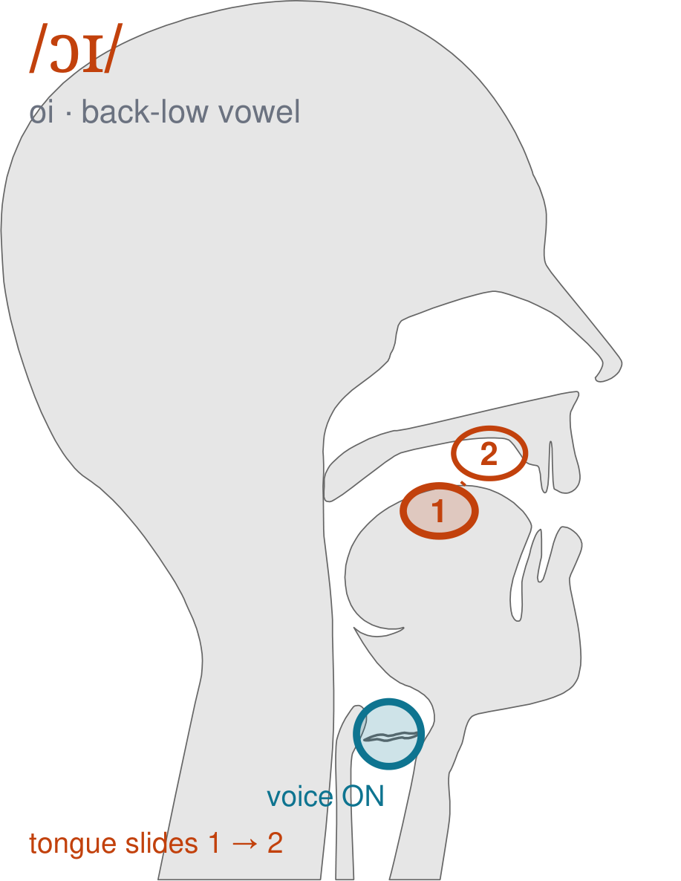
/ɔɪ/
written oi
Start with round lips and your mouth open, the way you say 'aw'. Then slide your tongue up and forward until you are smiling — /ɔɪ/, as in 'boy' and 'oil'.
CHECK: Mirror: round lips at the start, smiling lips at the end. If your lips never change, it is not the sound yet.
Notes:
SAY: We have a new sound today. It is written oi. Before we read it, we are going to make it.
SAY: Watch my mouth. Do not say anything yet — just watch.
DO: Make the sound three times, slowly, exaggerated. Say nothing else. Let them watch your mouth CHANGE — this sound moves from one position to another. Do not hold it still, and do not cut the slide short.
SAY: What did you notice about my mouth?
NOTE: Take two or three answers. Steer toward the moving part — lips, tongue, teeth, air, voice. Do not correct wrong noticing; ask another child.
SAY: Start with round lips and your mouth open, the way you say 'aw'. Then slide your tongue up and forward until you are smiling — /ɔɪ/, as in 'boy' and 'oil'.
SAY: Now you check it on yourself. Mirror: round lips at the start, smiling lips at the end. If your lips never change, it is not the sound yet.
DO: Every child does the check. Walk the room. You are looking for the check being DONE, not for the sound being perfect yet.
SAY: Say it with me. /ɔɪ/ … /ɔɪ/ … /ɔɪ/.
NOTE: Individual turns from four or five children, chosen so you hear the ones you are worried about. Give feedback on the MOUTH, not on the sound: 'your teeth were not on your lip' beats 'that was not quite right.'
NOTE: Watch for: Splitting it into two separate vowels — 'bo-y'. It is one slide, not two syllables.
NOTE: This sound does not exist in Somali, Arabic. For those children it is a new physical skill, not a reminder. Expect it to take days, and do not let the column start until the mouth can make it.

Slide 3
boy oil coin noise
hoist coy boil join
poise foist joy coil
Notes:
The slide starts blank. One click per row.
SAY: Down the first column. My pointer, your voice.
SAY: Now across the rows.
NOTE: down a column can be recited from memory; across cannot. A child who was strong going down and falls apart going across was reciting. That is what this step is for — the same reason a Qaida is drilled down, then across, then random.
SAY: Now I am going to jump around. Watch the pointer.
NOTE: anything missed here goes on tomorrow's warm-up.

Slide 4
loin moist Roy foil
void choice soy soil
joint voice toy toil
Notes:
The slide starts blank. One click per row.
SAY: Down the first column. My pointer, your voice.
SAY: Now across the rows.
NOTE: down a column can be recited from memory; across cannot. A child who was strong going down and falls apart going across was reciting. That is what this step is for — the same reason a Qaida is drilled down, then across, then random.
SAY: Now I am going to jump around. Watch the pointer.
NOTE: anything missed here goes on tomorrow's warm-up.

Slide 5
point Joyce broil spoil
poi joyful oily boyish
noy annoy broiling coins
Notes:
The slide starts blank. One click per row.
SAY: Down the first column. My pointer, your voice.
SAY: Now across the rows.
NOTE: down a column can be recited from memory; across cannot. A child who was strong going down and falls apart going across was reciting. That is what this step is for — the same reason a Qaida is drilled down, then across, then random.
SAY: Now I am going to jump around. Watch the pointer.
NOTE: anything missed here goes on tomorrow's warm-up.

Slide 6
Roy gave the toy to Joyce.
Notes:
The slide starts blank — click when the class is silent and looking, not before.
SAY: Read it in your head first. Put your finger up when you have it.
NOTE: wait for most fingers before calling on anyone. Silent-first is what makes this reading rather than listening.
SAY: Together: Roy gave the toy to Joyce.
NOTE: then two or three individual readers — never round the class in seating order.

Slide 7
The cat likes to annoy Joyce.
Notes:
The slide starts blank — click when the class is silent and looking, not before.
SAY: Read it in your head first. Put your finger up when you have it.
NOTE: wait for most fingers before calling on anyone. Silent-first is what makes this reading rather than listening.
SAY: Together: The cat likes to annoy Joyce.
NOTE: then two or three individual readers — never round the class in seating order.

Slide 8
Roy wants to join a club.
Notes:
The slide starts blank — click when the class is silent and looking, not before.
SAY: Read it in your head first. Put your finger up when you have it.
NOTE: wait for most fingers before calling on anyone. Silent-first is what makes this reading rather than listening.
SAY: Together: Roy wants to join a club.
NOTE: then two or three individual readers — never round the class in seating order.

Slide 9
He has a choice of two clubs.
Notes:
The slide starts blank — click when the class is silent and looking, not before.
SAY: Read it in your head first. Put your finger up when you have it.
NOTE: wait for most fingers before calling on anyone. Silent-first is what makes this reading rather than listening.
SAY: Together: He has a choice of two clubs.
NOTE: then two or three individual readers — never round the class in seating order.

Slide 10
Joyce has a jar of coins.
Notes:
The slide starts blank — click when the class is silent and looking, not before.
SAY: Read it in your head first. Put your finger up when you have it.
NOTE: wait for most fingers before calling on anyone. Silent-first is what makes this reading rather than listening.
SAY: Together: Joyce has a jar of coins.
NOTE: then two or three individual readers — never round the class in seating order.

Slide 11
The water is about to boil.
Notes:
The slide starts blank — click when the class is silent and looking, not before.
SAY: Read it in your head first. Put your finger up when you have it.
NOTE: wait for most fingers before calling on anyone. Silent-first is what makes this reading rather than listening.
SAY: Together: The water is about to boil.
NOTE: then two or three individual readers — never round the class in seating order.

Slide 12
annoy
broiling
coins
Notes:
The slide starts blank. Click ONE word per child as they come to you — the queue should not be able to rehearse the next one.
SAY: Before you go, three words, on your own.
NOTE: one child at a time as they line up. Mark 3, 2, or fewer. Two or fewer starts tomorrow's warm-up group. That is the whole reason for recording it — do not skip it, and do not make it public.

