Slide 1
Short e words · Short e sentences
Alpha-Phonics Lesson 16, Lesson 17 · p.23–25
Notes:
Grade 2, day 21 of 76. 30.4 minutes.
Segments today: WARM-UP, SOUND, BUILD, COLUMN, SHOW ME, DICTATION, SENTENCES, CLOSE
The talk on every slide is in these notes. SAY lines are read as written — they are the routines, and a routine whose wording drifts is one the children have to re-learn. NOTE lines are for you only.

Slide 2
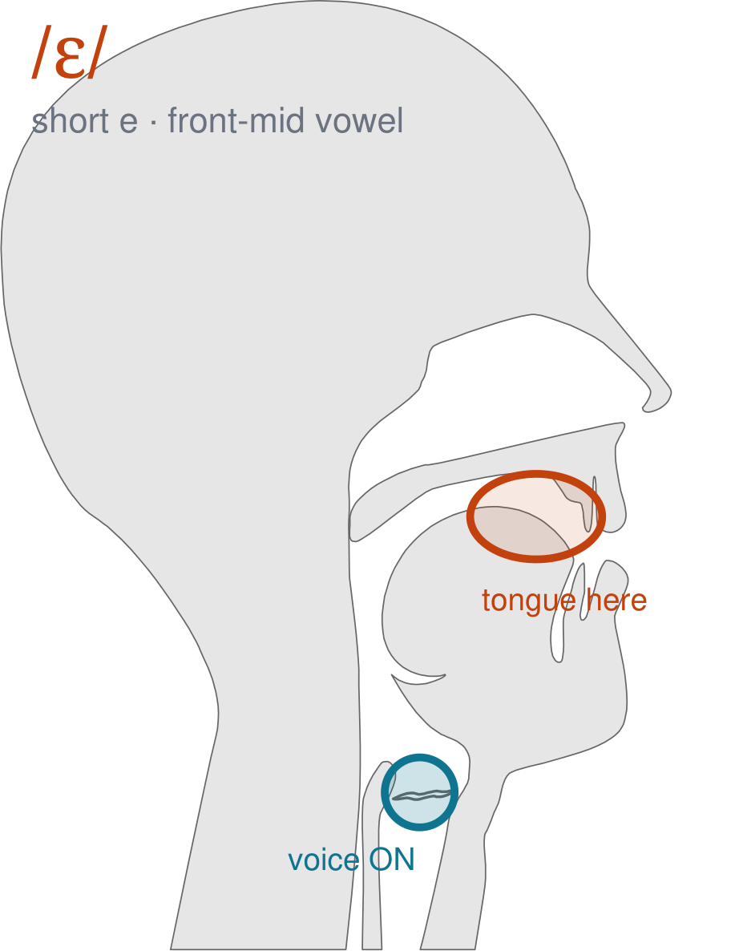
/ɛ/
written short e
Mouth open about half as wide as for short a. Lips still spread. Tongue in the middle — /e/, as in 'bed'.
CHECK: Say 'bad' then 'bed' with a hand under your chin. Feel the jaw come UP.
Notes:
SAY: We have a new sound today. It is the sound we call short e. Before we read it, we are going to make it.
SAY: Watch my mouth. Do not say anything yet — just watch.
DO: Make the sound three times, slowly, exaggerated. Say nothing else. Let them watch your front mid position.
SAY: What did you notice about my mouth?
NOTE: Take two or three answers. Steer toward the moving part — lips, tongue, teeth, air, voice. Do not correct wrong noticing; ask another child.
SAY: Mouth open about half as wide as for short a. Lips still spread. Tongue in the middle — /e/, as in 'bed'.
SAY: Now you check it on yourself. Say 'bad' then 'bed' with a hand under your chin. Feel the jaw come UP.
DO: Every child does the check. Walk the room. You are looking for the check being DONE, not for the sound being perfect yet.
SAY: Say it with me. /ɛ/ … /ɛ/ … /ɛ/.
NOTE: Individual turns from four or five children, chosen so you hear the ones you are worried about. Give feedback on the MOUTH, not on the sound: 'your teeth were not on your lip' beats 'that was not quite right.'
NOTE: Watch for: /æ/ and /ɪ/ — it sits between them.
NOTE: This sound does not exist in Arabic. For those children it is a new physical skill, not a reminder. Expect it to take days, and do not let the column start until the mouth can make it.

Slide 3
Ed egg ell Deb
beck bed Jeff beg
bell web deck fed
Notes:
The slide starts blank. One click per row.
SAY: Down the first column. My pointer, your voice.
SAY: Now across the rows.
NOTE: down a column can be recited from memory; across cannot. A child who was strong going down and falls apart going across was reciting. That is what this step is for — the same reason a Qaida is drilled down, then across, then random.
SAY: Now I am going to jump around. Watch the pointer.
NOTE: anything missed here goes on tomorrow's warm-up.

Slide 4
keg cell neck led
leg dell peck Ned
Meg fell red peg
Notes:
The slide starts blank. One click per row.
SAY: Down the first column. My pointer, your voice.
SAY: Now across the rows.
NOTE: down a column can be recited from memory; across cannot. A child who was strong going down and falls apart going across was reciting. That is what this step is for — the same reason a Qaida is drilled down, then across, then random.
SAY: Now I am going to jump around. Watch the pointer.
NOTE: anything missed here goes on tomorrow's warm-up.

Slide 5
Ted sell wed tell
well yell Continued gem
hem den fen hen
Notes:
The slide starts blank. One click per row.
SAY: Down the first column. My pointer, your voice.
SAY: Now across the rows.
NOTE: down a column can be recited from memory; across cannot. A child who was strong going down and falls apart going across was reciting. That is what this step is for — the same reason a Qaida is drilled down, then across, then random.
SAY: Now I am going to jump around. Watch the pointer.
NOTE: anything missed here goes on tomorrow's warm-up.

Slide 6
Jen Ken Len men
pen ten yen end
bend fend lend mend
Notes:
The slide starts blank. One click per row.
SAY: Down the first column. My pointer, your voice.
SAY: Now across the rows.
NOTE: down a column can be recited from memory; across cannot. A child who was strong going down and falls apart going across was reciting. That is what this step is for — the same reason a Qaida is drilled down, then across, then random.
SAY: Now I am going to jump around. Watch the pointer.
NOTE: anything missed here goes on tomorrow's warm-up.

Slide 7
rend send tend wend
pep rep yes Bess
less mess bet Rex
Notes:
The slide starts blank. One click per row.
SAY: Down the first column. My pointer, your voice.
SAY: Now across the rows.
NOTE: down a column can be recited from memory; across cannot. A child who was strong going down and falls apart going across was reciting. That is what this step is for — the same reason a Qaida is drilled down, then across, then random.
SAY: Now I am going to jump around. Watch the pointer.
NOTE: anything missed here goes on tomorrow's warm-up.

Slide 8
Bess fed Jack an egg.
Notes:
The slide starts blank — click when the class is silent and looking, not before.
SAY: Read it in your head first. Put your finger up when you have it.
NOTE: wait for most fingers before calling on anyone. Silent-first is what makes this reading rather than listening.
SAY: Together: Bess fed Jack an egg.
NOTE: then two or three individual readers — never round the class in seating order.

Slide 9
Can Rex tell Pam?
Notes:
The slide starts blank — click when the class is silent and looking, not before.
SAY: Read it in your head first. Put your finger up when you have it.
NOTE: wait for most fingers before calling on anyone. Silent-first is what makes this reading rather than listening.
SAY: Together: Can Rex tell Pam?
NOTE: then two or three individual readers — never round the class in seating order.

Slide 10
Deb had an egg.
Notes:
The slide starts blank — click when the class is silent and looking, not before.
SAY: Read it in your head first. Put your finger up when you have it.
NOTE: wait for most fingers before calling on anyone. Silent-first is what makes this reading rather than listening.
SAY: Together: Deb had an egg.
NOTE: then two or three individual readers — never round the class in seating order.

Slide 11
Dad let Ken get wet.
Notes:
The slide starts blank — click when the class is silent and looking, not before.
SAY: Read it in your head first. Put your finger up when you have it.
NOTE: wait for most fingers before calling on anyone. Silent-first is what makes this reading rather than listening.
SAY: Together: Dad let Ken get wet.
NOTE: then two or three individual readers — never round the class in seating order.

Slide 12
Deb has a red pen.
Notes:
The slide starts blank — click when the class is silent and looking, not before.
SAY: Read it in your head first. Put your finger up when you have it.
NOTE: wait for most fingers before calling on anyone. Silent-first is what makes this reading rather than listening.
SAY: Together: Deb has a red pen.
NOTE: then two or three individual readers — never round the class in seating order.

Slide 13
Send Len an ax.
Notes:
The slide starts blank — click when the class is silent and looking, not before.
SAY: Read it in your head first. Put your finger up when you have it.
NOTE: wait for most fingers before calling on anyone. Silent-first is what makes this reading rather than listening.
SAY: Together: Send Len an ax.
NOTE: then two or three individual readers — never round the class in seating order.

Slide 14
set
net
less
Notes:
The slide starts blank. Click ONE word per child as they come to you — the queue should not be able to rehearse the next one.
SAY: Before you go, three words, on your own.
NOTE: one child at a time as they line up. Mark 3, 2, or fewer. Two or fewer starts tomorrow's warm-up group. That is the whole reason for recording it — do not skip it, and do not make it public.

