Slide 1
Words with consonant blends · Sentences · Long a
Alpha-Phonics Lesson 70, Lesson 71, Lesson 72 · p.79–81
Notes:
Grade 2, day 54 of 76. 30.4 minutes.
Segments today: WARM-UP, SOUND, BUILD, COLUMN, SHOW ME, DICTATION, SENTENCES, CLOSE
The talk on every slide is in these notes. SAY lines are read as written — they are the routines, and a routine whose wording drifts is one the children have to re-learn. NOTE lines are for you only.

Slide 2
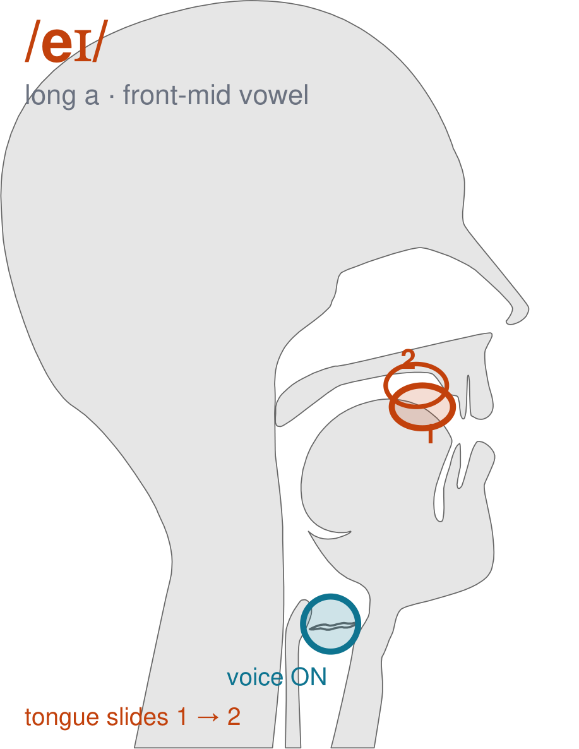
/eɪ/
written long a
Start with your mouth half open and your lips wide, like a small smile. Then slide your tongue UP and close your mouth a little as you finish. Two sounds glued together — /eɪ/, which is the name of the letter a.
CHECK: Hand under your chin. Say it slowly: your jaw comes UP at the end. If your jaw never moves, you are saying one sound where there should be two.
Notes:
SAY: We have a new sound today. It is the sound we call long a. Before we read it, we are going to make it.
SAY: Watch my mouth. Do not say anything yet — just watch.
DO: Make the sound three times, slowly, exaggerated. Say nothing else. Let them watch your mouth CHANGE — this sound moves from one position to another. Do not hold it still, and do not cut the slide short.
SAY: What did you notice about my mouth?
NOTE: Take two or three answers. Steer toward the moving part — lips, tongue, teeth, air, voice. Do not correct wrong noticing; ask another child.
SAY: Start with your mouth half open and your lips wide, like a small smile. Then slide your tongue UP and close your mouth a little as you finish. Two sounds glued together — /eɪ/, which is the name of the letter a.
SAY: Now you check it on yourself. Hand under your chin. Say it slowly: your jaw comes UP at the end. If your jaw never moves, you are saying one sound where there should be two.
DO: Every child does the check. Walk the room. You are looking for the check being DONE, not for the sound being perfect yet.
SAY: Say it with me. /eɪ/ … /eɪ/ … /eɪ/.
NOTE: Individual turns from four or five children, chosen so you hear the ones you are worried about. Give feedback on the MOUTH, not on the sound: 'your teeth were not on your lip' beats 'that was not quite right.'
NOTE: Watch for: A flat 'eh' with no slide. Arabic, Somali and Urdu all have a plain long e, so the vowel sounds close but stops halfway and 'made' comes out near 'med'. The slide is not decoration; it is the sound.
NOTE: This sound does not exist in Somali, Arabic, Urdu. For those children it is a new physical skill, not a reminder. Expect it to take days, and do not let the column start until the mouth can make it.

Slide 3
truck bless Jump skip
then Dutch swift spun
with quick pest grudge
Notes:
The slide starts blank. One click per row.
SAY: Down the first column. My pointer, your voice.
SAY: Now across the rows.
NOTE: down a column can be recited from memory; across cannot. A child who was strong going down and falls apart going across was reciting. That is what this step is for — the same reason a Qaida is drilled down, then across, then random.
SAY: Now I am going to jump around. Watch the pointer.
NOTE: anything missed here goes on tomorrow's warm-up.

Slide 4
shrimp dish glass shack
bank plum king fudge
fond dump frill act
Notes:
The slide starts blank. One click per row.
SAY: Down the first column. My pointer, your voice.
SAY: Now across the rows.
NOTE: down a column can be recited from memory; across cannot. A child who was strong going down and falls apart going across was reciting. That is what this step is for — the same reason a Qaida is drilled down, then across, then random.
SAY: Now I am going to jump around. Watch the pointer.
NOTE: anything missed here goes on tomorrow's warm-up.

Slide 5
task flag lift sash
cliff left crux kept
clasp draft trick dwell
Notes:
The slide starts blank. One click per row.
SAY: Down the first column. My pointer, your voice.
SAY: Now across the rows.
NOTE: down a column can be recited from memory; across cannot. A child who was strong going down and falls apart going across was reciting. That is what this step is for — the same reason a Qaida is drilled down, then across, then random.
SAY: Now I am going to jump around. Watch the pointer.
NOTE: anything missed here goes on tomorrow's warm-up.

Slide 6
chest France clap bridge
hitch slack edge next
spring golf lunch witch
Notes:
The slide starts blank. One click per row.
SAY: Down the first column. My pointer, your voice.
SAY: Now across the rows.
NOTE: down a column can be recited from memory; across cannot. A child who was strong going down and falls apart going across was reciting. That is what this step is for — the same reason a Qaida is drilled down, then across, then random.
SAY: Now I am going to jump around. Watch the pointer.
NOTE: anything missed here goes on tomorrow's warm-up.

Slide 7
elm flash smash scant
twist strand string thrush
The cat sat still
Notes:
The slide starts blank. One click per row.
SAY: Down the first column. My pointer, your voice.
SAY: Now across the rows.
NOTE: down a column can be recited from memory; across cannot. A child who was strong going down and falls apart going across was reciting. That is what this step is for — the same reason a Qaida is drilled down, then across, then random.
SAY: Now I am going to jump around. Watch the pointer.
NOTE: anything missed here goes on tomorrow's warm-up.

Slide 8
Bill had fudge with his lunch.
Notes:
The slide starts blank — click when the class is silent and looking, not before.
SAY: Read it in your head first. Put your finger up when you have it.
NOTE: wait for most fingers before calling on anyone. Silent-first is what makes this reading rather than listening.
SAY: Together: Bill had fudge with his lunch.
NOTE: then two or three individual readers — never round the class in seating order.

Slide 9
Patrick drank a glass of milk.
Notes:
The slide starts blank — click when the class is silent and looking, not before.
SAY: Read it in your head first. Put your finger up when you have it.
NOTE: wait for most fingers before calling on anyone. Silent-first is what makes this reading rather than listening.
SAY: Together: Patrick drank a glass of milk.
NOTE: then two or three individual readers — never round the class in seating order.

Slide 10
Gwen put cash in the bank.
Notes:
The slide starts blank — click when the class is silent and looking, not before.
SAY: Read it in your head first. Put your finger up when you have it.
NOTE: wait for most fingers before calling on anyone. Silent-first is what makes this reading rather than listening.
SAY: Together: Gwen put cash in the bank.
NOTE: then two or three individual readers — never round the class in seating order.

Slide 11
Pam had a stiff neck.
Notes:
The slide starts blank — click when the class is silent and looking, not before.
SAY: Read it in your head first. Put your finger up when you have it.
NOTE: wait for most fingers before calling on anyone. Silent-first is what makes this reading rather than listening.
SAY: Together: Pam had a stiff neck.
NOTE: then two or three individual readers — never round the class in seating order.

Slide 12
The king of France was plump.
Notes:
The slide starts blank — click when the class is silent and looking, not before.
SAY: Read it in your head first. Put your finger up when you have it.
NOTE: wait for most fingers before calling on anyone. Silent-first is what makes this reading rather than listening.
SAY: Together: The king of France was plump.
NOTE: then two or three individual readers — never round the class in seating order.

Slide 13
Frank is a prince.
Notes:
The slide starts blank — click when the class is silent and looking, not before.
SAY: Read it in your head first. Put your finger up when you have it.
NOTE: wait for most fingers before calling on anyone. Silent-first is what makes this reading rather than listening.
SAY: Together: Frank is a prince.
NOTE: then two or three individual readers — never round the class in seating order.

Slide 14
cape
gap
gape
Notes:
The slide starts blank. Click ONE word per child as they come to you — the queue should not be able to rehearse the next one.
SAY: Before you go, three words, on your own.
NOTE: one child at a time as they line up. Mark 3, 2, or fewer. Two or fewer starts tomorrow's warm-up group. That is the whole reason for recording it — do not skip it, and do not make it public.

