Slide 1
Spelling forms ough and augh · f as gh · Long o as o-e
Alpha-Phonics Lesson 101, Lesson 102, Lesson 103 · p.109–110
Notes:
Grade 2, day 66 of 76. 30.4 minutes.
Segments today: WARM-UP, SOUND, BUILD, COLUMN, SHOW ME, DICTATION, SENTENCES, CLOSE
The talk on every slide is in these notes. SAY lines are read as written — they are the routines, and a routine whose wording drifts is one the children have to re-learn. NOTE lines are for you only.

Slide 2
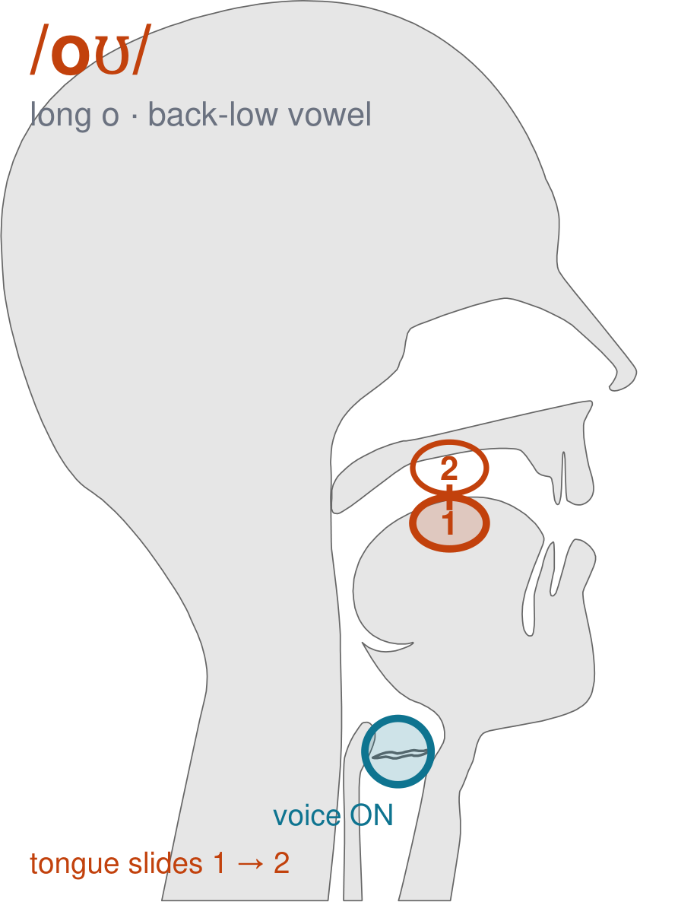
/oʊ/
written long o
Push your lips into a round O. Start with your mouth open, then close your lips into a smaller, tighter circle as you finish — /oʊ/, the name of the letter o.
CHECK: Mirror: your lips must get SMALLER and rounder while you say it. If your lips hold still, you are saying a plain o.
Notes:
SAY: We have a new sound today. It is the sound we call long o. Before we read it, we are going to make it.
SAY: Watch my mouth. Do not say anything yet — just watch.
DO: Make the sound three times, slowly, exaggerated. Say nothing else. Let them watch your mouth CHANGE — this sound moves from one position to another. Do not hold it still, and do not cut the slide short.
SAY: What did you notice about my mouth?
NOTE: Take two or three answers. Steer toward the moving part — lips, tongue, teeth, air, voice. Do not correct wrong noticing; ask another child.
SAY: Push your lips into a round O. Start with your mouth open, then close your lips into a smaller, tighter circle as you finish — /oʊ/, the name of the letter o.
SAY: Now you check it on yourself. Mirror: your lips must get SMALLER and rounder while you say it. If your lips hold still, you are saying a plain o.
DO: Every child does the check. Walk the room. You are looking for the check being DONE, not for the sound being perfect yet.
SAY: Say it with me. /oʊ/ … /oʊ/ … /oʊ/.
NOTE: Individual turns from four or five children, chosen so you hear the ones you are worried about. Give feedback on the MOUTH, not on the sound: 'your teeth were not on your lip' beats 'that was not quite right.'
NOTE: Watch for: A plain held /o/. All three home languages have one, which is why this sound gets waved through and then turns up wrong in every long-o word for the rest of the year.
NOTE: This sound does not exist in Somali, Arabic, Urdu. For those children it is a new physical skill, not a reminder. Expect it to take days, and do not let the column start until the mouth can make it.

Slide 3
ough augh ought fought
caught bought sought taught
brought thought daughter though
Notes:
The slide starts blank. One click per row.
SAY: Down the first column. My pointer, your voice.
SAY: Now across the rows.
NOTE: down a column can be recited from memory; across cannot. A child who was strong going down and falls apart going across was reciting. That is what this step is for — the same reason a Qaida is drilled down, then across, then random.
SAY: Now I am going to jump around. Watch the pointer.
NOTE: anything missed here goes on tomorrow's warm-up.

Slide 4
slaughter rough laugh tough
laughing cough laughter coughing
ough augh ought fought
Notes:
The slide starts blank. One click per row.
SAY: Down the first column. My pointer, your voice.
SAY: Now across the rows.
NOTE: down a column can be recited from memory; across cannot. A child who was strong going down and falls apart going across was reciting. That is what this step is for — the same reason a Qaida is drilled down, then across, then random.
SAY: Now I am going to jump around. Watch the pointer.
NOTE: anything missed here goes on tomorrow's warm-up.

Slide 5
caught bought sought taught
brought thought daughter though
slaughter rough laugh tough
Notes:
The slide starts blank. One click per row.
SAY: Down the first column. My pointer, your voice.
SAY: Now across the rows.
NOTE: down a column can be recited from memory; across cannot. A child who was strong going down and falls apart going across was reciting. That is what this step is for — the same reason a Qaida is drilled down, then across, then random.
SAY: Now I am going to jump around. Watch the pointer.
NOTE: anything missed here goes on tomorrow's warm-up.

Slide 6
laughing cough laughter coughing
robe hole bone lobe
mole cone globe pole
Notes:
The slide starts blank. One click per row.
SAY: Down the first column. My pointer, your voice.
SAY: Now across the rows.
NOTE: down a column can be recited from memory; across cannot. A child who was strong going down and falls apart going across was reciting. That is what this step is for — the same reason a Qaida is drilled down, then across, then random.
SAY: Now I am going to jump around. Watch the pointer.
NOTE: anything missed here goes on tomorrow's warm-up.

Slide 7
lone probe role tone
zone code stole phone
mode whole stone rode
Notes:
The slide starts blank. One click per row.
SAY: Down the first column. My pointer, your voice.
SAY: Now across the rows.
NOTE: down a column can be recited from memory; across cannot. A child who was strong going down and falls apart going across was reciting. That is what this step is for — the same reason a Qaida is drilled down, then across, then random.
SAY: Now I am going to jump around. Watch the pointer.
NOTE: anything missed here goes on tomorrow's warm-up.

Slide 8
I bought candy and gum.
Notes:
The slide starts blank — click when the class is silent and looking, not before.
SAY: Read it in your head first. Put your finger up when you have it.
NOTE: wait for most fingers before calling on anyone. Silent-first is what makes this reading rather than listening.
SAY: Together: I bought candy and gum.
NOTE: then two or three individual readers — never round the class in seating order.

Slide 9
Paul caught the balL He thought the ball was fast.
Notes:
The slide starts blank — click when the class is silent and looking, not before.
SAY: Read it in your head first. Put your finger up when you have it.
NOTE: wait for most fingers before calling on anyone. Silent-first is what makes this reading rather than listening.
SAY: Together: Paul caught the balL He thought the ball was fast.
NOTE: then two or three individual readers — never round the class in seating order.

Slide 10
Dad taught a tennis lesson.
Notes:
The slide starts blank — click when the class is silent and looking, not before.
SAY: Read it in your head first. Put your finger up when you have it.
NOTE: wait for most fingers before calling on anyone. Silent-first is what makes this reading rather than listening.
SAY: Together: Dad taught a tennis lesson.
NOTE: then two or three individual readers — never round the class in seating order.

Slide 11
Dad has a cough.
Notes:
The slide starts blank — click when the class is silent and looking, not before.
SAY: Read it in your head first. Put your finger up when you have it.
NOTE: wait for most fingers before calling on anyone. Silent-first is what makes this reading rather than listening.
SAY: Together: Dad has a cough.
NOTE: then two or three individual readers — never round the class in seating order.

Slide 12
Mom gave him a cough drop.
Notes:
The slide starts blank — click when the class is silent and looking, not before.
SAY: Read it in your head first. Put your finger up when you have it.
NOTE: wait for most fingers before calling on anyone. Silent-first is what makes this reading rather than listening.
SAY: Together: Mom gave him a cough drop.
NOTE: then two or three individual readers — never round the class in seating order.

Slide 13
The steak was tough.
Notes:
The slide starts blank — click when the class is silent and looking, not before.
SAY: Read it in your head first. Put your finger up when you have it.
NOTE: wait for most fingers before calling on anyone. Silent-first is what makes this reading rather than listening.
SAY: Together: The steak was tough.
NOTE: then two or three individual readers — never round the class in seating order.

Slide 14
owe
doze
froze
Notes:
The slide starts blank. Click ONE word per child as they come to you — the queue should not be able to rehearse the next one.
SAY: Before you go, three words, on your own.
NOTE: one child at a time as they line up. Mark 3, 2, or fewer. Two or fewer starts tomorrow's warm-up group. That is the whole reason for recording it — do not skip it, and do not make it public.

