Slide 1
Long o as in old; sentences · Common irregular words; sentences · oo as in good food
Alpha-Phonics Lesson 107, Lesson 108, Lesson 109 · p.114–116
Notes:
Grade 2, day 68 of 76. 31.4 minutes.
Segments today: WARM-UP, SOUND, BUILD, COLUMN, SHOW ME, DICTATION, SENTENCES, CLOSE
The talk on every slide is in these notes. SAY lines are read as written — they are the routines, and a routine whose wording drifts is one the children have to re-learn. NOTE lines are for you only.

Slide 2
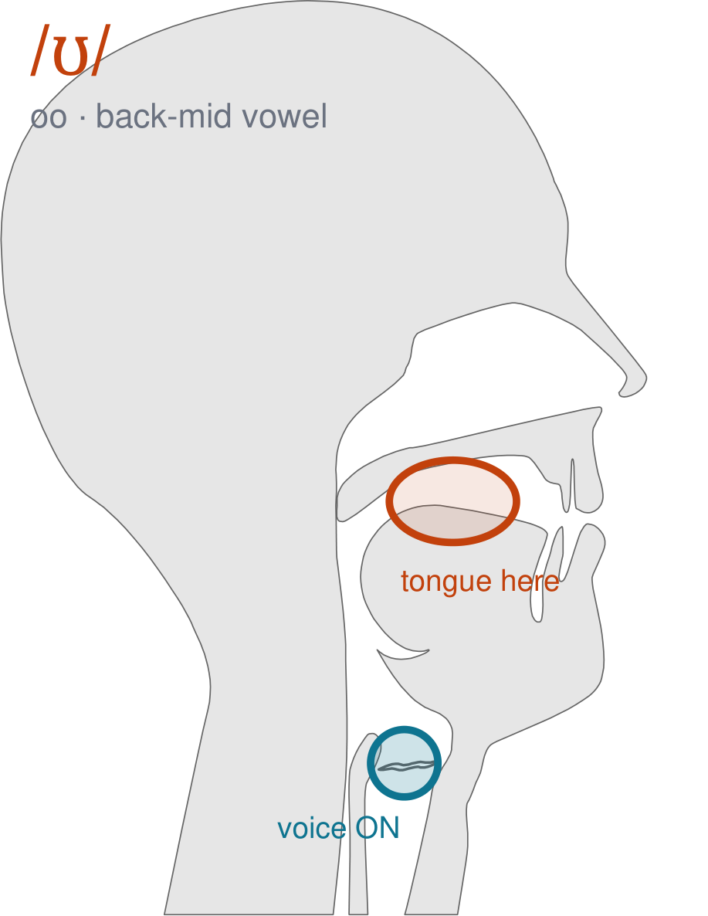
/ʊ/
written oo
Almost the same as oooo, but shorter and looser. Lips a little round, but relaxed, and your tongue drops a little — the oo in 'book' and 'good'.
CHECK: Say 'food', then 'good'. Feel your lips RELAX on the second one, and notice it is shorter.
Notes:
SAY: We have a new sound today. It is written oo. Before we read it, we are going to make it.
SAY: Watch my mouth. Do not say anything yet — just watch.
DO: Make the sound three times, slowly, exaggerated. Say nothing else. Let them watch your back mid position.
SAY: What did you notice about my mouth?
NOTE: Take two or three answers. Steer toward the moving part — lips, tongue, teeth, air, voice. Do not correct wrong noticing; ask another child.
SAY: Almost the same as oooo, but shorter and looser. Lips a little round, but relaxed, and your tongue drops a little — the oo in 'book' and 'good'.
SAY: Now you check it on yourself. Say 'food', then 'good'. Feel your lips RELAX on the second one, and notice it is shorter.
DO: Every child does the check. Walk the room. You are looking for the check being DONE, not for the sound being perfect yet.
SAY: Say it with me. /ʊ/ … /ʊ/ … /ʊ/.
NOTE: Individual turns from four or five children, chosen so you hear the ones you are worried about. Give feedback on the MOUTH, not on the sound: 'your teeth were not on your lip' beats 'that was not quite right.'
NOTE: Watch for: /uː/. Arabic has long and short u, but they are the same vowel held for different lengths — this one is a different vowel, not a shorter one, and that is the thing to teach.
NOTE: This sound does not exist in Arabic. For those children it is a new physical skill, not a reminder. Expect it to take days, and do not let the column start until the mouth can make it.
SAY: These letters you already know the sound of: oo. Say each one as I point.
NOTE: Naming, not teaching — these sounds exist in the children's home languages. If one of them is genuinely shaky for a child, that is a warm-up item tomorrow, not a five-minute detour now.

Slide 3
old hold bold mold
cold sold fold gold
scold told to do
Notes:
The slide starts blank. One click per row.
SAY: Down the first column. My pointer, your voice.
SAY: Now across the rows.
NOTE: down a column can be recited from memory; across cannot. A child who was strong going down and falls apart going across was reciting. That is what this step is for — the same reason a Qaida is drilled down, then across, then random.
SAY: Now I am going to jump around. Watch the pointer.
NOTE: anything missed here goes on tomorrow's warm-up.

Slide 4
too two who you
youth young know went
the phone Did what
Notes:
The slide starts blank. One click per row.
SAY: Down the first column. My pointer, your voice.
SAY: Now across the rows.
NOTE: down a column can be recited from memory; across cannot. A child who was strong going down and falls apart going across was reciting. That is what this step is for — the same reason a Qaida is drilled down, then across, then random.
SAY: Now I am going to jump around. Watch the pointer.
NOTE: anything missed here goes on tomorrow's warm-up.

Slide 5
were told of must
think are want go
alone is high big
Notes:
The slide starts blank. One click per row.
SAY: Down the first column. My pointer, your voice.
SAY: Now across the rows.
NOTE: down a column can be recited from memory; across cannot. A child who was strong going down and falls apart going across was reciting. That is what this step is for — the same reason a Qaida is drilled down, then across, then random.
SAY: Now I am going to jump around. Watch the pointer.
NOTE: anything missed here goes on tomorrow's warm-up.

Slide 6
Give it back him
shall man sold good
food coo boom boon
Notes:
The slide starts blank. One click per row.
SAY: Down the first column. My pointer, your voice.
SAY: Now across the rows.
NOTE: down a column can be recited from memory; across cannot. A child who was strong going down and falls apart going across was reciting. That is what this step is for — the same reason a Qaida is drilled down, then across, then random.
SAY: Now I am going to jump around. Watch the pointer.
NOTE: anything missed here goes on tomorrow's warm-up.

Slide 7
coop boot boo doom
moon loop coot moo
cool room noon hoop
Notes:
The slide starts blank. One click per row.
SAY: Down the first column. My pointer, your voice.
SAY: Now across the rows.
NOTE: down a column can be recited from memory; across cannot. A child who was strong going down and falls apart going across was reciting. That is what this step is for — the same reason a Qaida is drilled down, then across, then random.
SAY: Now I am going to jump around. Watch the pointer.
NOTE: anything missed here goes on tomorrow's warm-up.

Slide 8
"Hold my hand," she said.
Notes:
The slide starts blank — click when the class is silent and looking, not before.
SAY: Read it in your head first. Put your finger up when you have it.
NOTE: wait for most fingers before calling on anyone. Silent-first is what makes this reading rather than listening.
SAY: Together: "Hold my hand," she said.
NOTE: then two or three individual readers — never round the class in seating order.

Slide 9
He was lost.
Notes:
The slide starts blank — click when the class is silent and looking, not before.
SAY: Read it in your head first. Put your finger up when you have it.
NOTE: wait for most fingers before calling on anyone. Silent-first is what makes this reading rather than listening.
SAY: Together: He was lost.
NOTE: then two or three individual readers — never round the class in seating order.

Slide 10
He sold his home.
Notes:
The slide starts blank — click when the class is silent and looking, not before.
SAY: Read it in your head first. Put your finger up when you have it.
NOTE: wait for most fingers before calling on anyone. Silent-first is what makes this reading rather than listening.
SAY: Together: He sold his home.
NOTE: then two or three individual readers — never round the class in seating order.

Slide 11
I know what he told her.
Notes:
The slide starts blank — click when the class is silent and looking, not before.
SAY: Read it in your head first. Put your finger up when you have it.
NOTE: wait for most fingers before calling on anyone. Silent-first is what makes this reading rather than listening.
SAY: Together: I know what he told her.
NOTE: then two or three individual readers — never round the class in seating order.

Slide 12
In winter it is cold most of the time.
Notes:
The slide starts blank — click when the class is silent and looking, not before.
SAY: Read it in your head first. Put your finger up when you have it.
NOTE: wait for most fingers before calling on anyone. Silent-first is what makes this reading rather than listening.
SAY: Together: In winter it is cold most of the time.
NOTE: then two or three individual readers — never round the class in seating order.

Slide 13
Bob sold his gold ring.
Notes:
The slide starts blank — click when the class is silent and looking, not before.
SAY: Read it in your head first. Put your finger up when you have it.
NOTE: wait for most fingers before calling on anyone. Silent-first is what makes this reading rather than listening.
SAY: Together: Bob sold his gold ring.
NOTE: then two or three individual readers — never round the class in seating order.

Slide 14
flood
blood
floor
Notes:
The slide starts blank. Click ONE word per child as they come to you — the queue should not be able to rehearse the next one.
SAY: Before you go, three words, on your own.
NOTE: one child at a time as they line up. Mark 3, 2, or fewer. Two or fewer starts tomorrow's warm-up group. That is the whole reason for recording it — do not skip it, and do not make it public.

