Slide 1
Sentences · oy as in boy; oi as in oil; sentences · Long u as u-e; sentences
Alpha-Phonics Lesson 113, Lesson 114, Lesson 115 · p.120–122
Notes:
Grade 2, day 70 of 76. 31.4 minutes.
Segments today: WARM-UP, SOUND, BUILD, COLUMN, SHOW ME, DICTATION, SENTENCES, CLOSE
The talk on every slide is in these notes. SAY lines are read as written — they are the routines, and a routine whose wording drifts is one the children have to re-learn. NOTE lines are for you only.

Slide 2
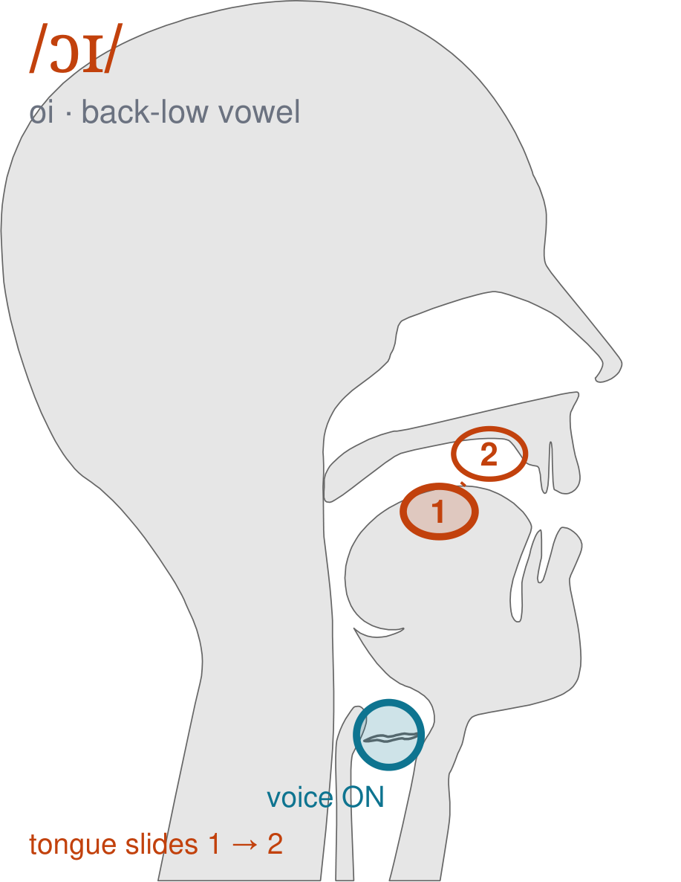
/ɔɪ/
written oi
Start with round lips and your mouth open, the way you say 'aw'. Then slide your tongue up and forward until you are smiling — /ɔɪ/, as in 'boy' and 'oil'.
CHECK: Mirror: round lips at the start, smiling lips at the end. If your lips never change, it is not the sound yet.
Notes:
SAY: We have a new sound today. It is written oi. Before we read it, we are going to make it.
SAY: Watch my mouth. Do not say anything yet — just watch.
DO: Make the sound three times, slowly, exaggerated. Say nothing else. Let them watch your mouth CHANGE — this sound moves from one position to another. Do not hold it still, and do not cut the slide short.
SAY: What did you notice about my mouth?
NOTE: Take two or three answers. Steer toward the moving part — lips, tongue, teeth, air, voice. Do not correct wrong noticing; ask another child.
SAY: Start with round lips and your mouth open, the way you say 'aw'. Then slide your tongue up and forward until you are smiling — /ɔɪ/, as in 'boy' and 'oil'.
SAY: Now you check it on yourself. Mirror: round lips at the start, smiling lips at the end. If your lips never change, it is not the sound yet.
DO: Every child does the check. Walk the room. You are looking for the check being DONE, not for the sound being perfect yet.
SAY: Say it with me. /ɔɪ/ … /ɔɪ/ … /ɔɪ/.
NOTE: Individual turns from four or five children, chosen so you hear the ones you are worried about. Give feedback on the MOUTH, not on the sound: 'your teeth were not on your lip' beats 'that was not quite right.'
NOTE: Watch for: Splitting it into two separate vowels — 'bo-y'. It is one slide, not two syllables.
NOTE: This sound does not exist in Somali, Arabic. For those children it is a new physical skill, not a reminder. Expect it to take days, and do not let the column start until the mouth can make it.
SAY: These letters you already know the sound of: long u. Say each one as I point.
NOTE: Naming, not teaching — these sounds exist in the children's home languages. If one of them is genuinely shaky for a child, that is a warm-up item tomorrow, not a five-minute detour now.

Slide 3
How did the cow
get out of house
mouse let her found
Notes:
The slide starts blank. One click per row.
SAY: Down the first column. My pointer, your voice.
SAY: Now across the rows.
NOTE: down a column can be recited from memory; across cannot. A child who was strong going down and falls apart going across was reciting. That is what this step is for — the same reason a Qaida is drilled down, then across, then random.
SAY: Now I am going to jump around. Watch the pointer.
NOTE: anything missed here goes on tomorrow's warm-up.

Slide 4
near Brother said They
loud sound fell down
Ouch clown ran went
Notes:
The slide starts blank. One click per row.
SAY: Down the first column. My pointer, your voice.
SAY: Now across the rows.
NOTE: down a column can be recited from memory; across cannot. A child who was strong going down and falls apart going across was reciting. That is what this step is for — the same reason a Qaida is drilled down, then across, then random.
SAY: Now I am going to jump around. Watch the pointer.
NOTE: anything missed here goes on tomorrow's warm-up.

Slide 5
downtown took an hour
to find was in
crowd and then she
Notes:
The slide starts blank. One click per row.
SAY: Down the first column. My pointer, your voice.
SAY: Now across the rows.
NOTE: down a column can be recited from memory; across cannot. A child who was strong going down and falls apart going across was reciting. That is what this step is for — the same reason a Qaida is drilled down, then across, then random.
SAY: Now I am going to jump around. Watch the pointer.
NOTE: anything missed here goes on tomorrow's warm-up.

Slide 6
around tower now brown
Will you come home
Not Bow wow dog
Notes:
The slide starts blank. One click per row.
SAY: Down the first column. My pointer, your voice.
SAY: Now across the rows.
NOTE: down a column can be recited from memory; across cannot. A child who was strong going down and falls apart going across was reciting. That is what this step is for — the same reason a Qaida is drilled down, then across, then random.
SAY: Now I am going to jump around. Watch the pointer.
NOTE: anything missed here goes on tomorrow's warm-up.

Slide 7
man came Your is
town he chased round
boy oil coin noise
Notes:
The slide starts blank. One click per row.
SAY: Down the first column. My pointer, your voice.
SAY: Now across the rows.
NOTE: down a column can be recited from memory; across cannot. A child who was strong going down and falls apart going across was reciting. That is what this step is for — the same reason a Qaida is drilled down, then across, then random.
SAY: Now I am going to jump around. Watch the pointer.
NOTE: anything missed here goes on tomorrow's warm-up.

Slide 8
How did the cow get out of the house?
Notes:
The slide starts blank — click when the class is silent and looking, not before.
SAY: Read it in your head first. Put your finger up when you have it.
NOTE: wait for most fingers before calling on anyone. Silent-first is what makes this reading rather than listening.
SAY: Together: How did the cow get out of the house?
NOTE: then two or three individual readers — never round the class in seating order.

Slide 9
A mouse let her out.
Notes:
The slide starts blank — click when the class is silent and looking, not before.
SAY: Read it in your head first. Put your finger up when you have it.
NOTE: wait for most fingers before calling on anyone. Silent-first is what makes this reading rather than listening.
SAY: Together: A mouse let her out.
NOTE: then two or three individual readers — never round the class in seating order.

Slide 10
"I found the cow near the house," Brother said.
Notes:
The slide starts blank — click when the class is silent and looking, not before.
SAY: Read it in your head first. Put your finger up when you have it.
NOTE: wait for most fingers before calling on anyone. Silent-first is what makes this reading rather than listening.
SAY: Together: "I found the cow near the house," Brother said.
NOTE: then two or three individual readers — never round the class in seating order.

Slide 11
The house fell down.
Notes:
The slide starts blank — click when the class is silent and looking, not before.
SAY: Read it in your head first. Put your finger up when you have it.
NOTE: wait for most fingers before calling on anyone. Silent-first is what makes this reading rather than listening.
SAY: Together: The house fell down.
NOTE: then two or three individual readers — never round the class in seating order.

Slide 12
"Ouch," said the clown.
Notes:
The slide starts blank — click when the class is silent and looking, not before.
SAY: Read it in your head first. Put your finger up when you have it.
NOTE: wait for most fingers before calling on anyone. Silent-first is what makes this reading rather than listening.
SAY: Together: "Ouch," said the clown.
NOTE: then two or three individual readers — never round the class in seating order.

Slide 13
The clown ran out of the house.
Notes:
The slide starts blank — click when the class is silent and looking, not before.
SAY: Read it in your head first. Put your finger up when you have it.
NOTE: wait for most fingers before calling on anyone. Silent-first is what makes this reading rather than listening.
SAY: Together: The clown ran out of the house.
NOTE: then two or three individual readers — never round the class in seating order.

Slide 14
spruce
huge
muse
Notes:
The slide starts blank. Click ONE word per child as they come to you — the queue should not be able to rehearse the next one.
SAY: Before you go, three words, on your own.
NOTE: one child at a time as they line up. Mark 3, 2, or fewer. Two or fewer starts tomorrow's warm-up group. That is the whole reason for recording it — do not skip it, and do not make it public.

