Slide 1
Consonants d, D, w
Alpha-Phonics Lesson 4 · p.5
Notes:
Grade K, day 6 of 184. 28.4 minutes.
Segments today: WARM-UP, SOUND, BUILD, COLUMN, SHOW ME, DICTATION, SENTENCES, CLOSE
The talk on every slide is in these notes. SAY lines are read as written — they are the routines, and a routine whose wording drifts is one the children have to re-learn. NOTE lines are for you only.

Slide 2
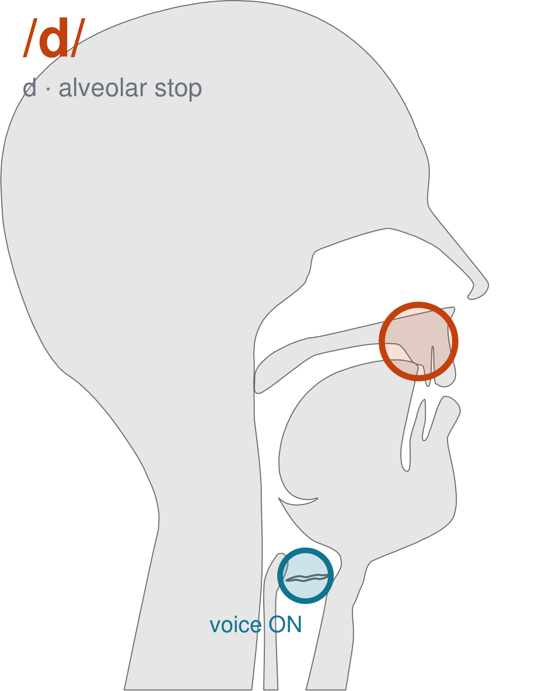
/d/
written d
Tongue tip on the ridge behind your top teeth, same as /t/. Voice ON — /d/.
CHECK: Hand on your throat: /d/ buzzes, /t/ does not.
Notes:
SAY: We have a new sound today. It is written d. Before we read it, we are going to make it.
SAY: Watch my mouth. Do not say anything yet — just watch.
DO: Make the sound three times, slowly, exaggerated. Say nothing else. Let them watch your alveolar position.
SAY: What did you notice about my mouth?
NOTE: Take two or three answers. Steer toward the moving part — lips, tongue, teeth, air, voice. Do not correct wrong noticing; ask another child.
SAY: Tongue tip on the ridge behind your top teeth, same as /t/. Voice ON — /d/.
SAY: Now you check it on yourself. Hand on your throat: /d/ buzzes, /t/ does not.
DO: Every child does the check. Walk the room. You are looking for the check being DONE, not for the sound being perfect yet.
SAY: Say it with me. /d/ … /d/ … /d/.
NOTE: Individual turns from four or five children, chosen so you hear the ones you are worried about. Give feedback on the MOUTH, not on the sound: 'your teeth were not on your lip' beats 'that was not quite right.'
NOTE: Watch for: /t/.
NOTE: This sound does not exist in Urdu. For those children it is a new physical skill, not a reminder. Expect it to take days, and do not let the column start until the mouth can make it.
SAY: One more sound you will see today: /w/, written w. Push your lips out into a tight little circle, like blowing out a candle, then open them into the next sound — w.
NOTE: Quick introduction only — /w/ gets its full lesson in a day or two. Today the children just need it in the mouth before they meet it in the column.

Slide 3
a
d
ad
Notes:
The slide starts blank. Click for each piece: a … d … then ad.
SAY: a … then d … put them together: ad.
NOTE: build it on the board beside the slide and LEAVE the pieces up. The child has to see that the whole word is made of the parts still visible next to it. Erasing the steps erases the reason.

Slide 4
d
ad
dad
Notes:
The slide starts blank. Click for each piece: d … ad … then dad.
SAY: d … then ad … put them together: dad.
NOTE: build it on the board beside the slide and LEAVE the pieces up. The child has to see that the whole word is made of the parts still visible next to it. Erasing the steps erases the reason.

Slide 5
w
ax
wax
Notes:
The slide starts blank. Click for each piece: w … ax … then wax.
SAY: w … then ax … put them together: wax.
NOTE: build it on the board beside the slide and LEAVE the pieces up. The child has to see that the whole word is made of the parts still visible next to it. Erasing the steps erases the reason.

Slide 6
D
an
Dan
Notes:
The slide starts blank. Click for each piece: D … an … then Dan.
SAY: D … then an … put them together: Dan.
NOTE: build it on the board beside the slide and LEAVE the pieces up. The child has to see that the whole word is made of the parts still visible next to it. Erasing the steps erases the reason.

Slide 7
am an as at
ax dad wax Dan
Notes:
The slide starts blank. One click per row.
SAY: Down the first column. My pointer, your voice.
SAY: Now across the rows.
NOTE: down a column can be recited from memory; across cannot. A child who was strong going down and falls apart going across was reciting. That is what this step is for — the same reason a Qaida is drilled down, then across, then random.
SAY: Now I am going to jump around. Watch the pointer.
NOTE: anything missed here goes on tomorrow's warm-up.

Slide 8
Sam has an ax.
Notes:
The slide starts blank — click when the class is silent and looking, not before.
SAY: Read it in your head first. Put your finger up when you have it.
NOTE: wait for most fingers before calling on anyone. Silent-first is what makes this reading rather than listening.
SAY: Together: Sam has an ax.
NOTE: then two or three individual readers — never round the class in seating order.

Slide 9
dad
wax
Dan
Notes:
The slide starts blank. Click ONE word per child as they come to you — the queue should not be able to rehearse the next one.
SAY: Before you go, three words, on your own.
NOTE: one child at a time as they line up. Mark 3, 2, or fewer. Two or fewer starts tomorrow's warm-up group. That is the whole reason for recording it — do not skip it, and do not make it public.

