Slide 1
Consonants l, b, c, g, f, j, n
Alpha-Phonics Lesson 8 · p.9–10
Notes:
Grade K, day 12 of 184. 27.9 minutes.
Segments today: WARM-UP, SOUND, BUILD, COLUMN, SHOW ME, DICTATION, CLOSE
The talk on every slide is in these notes. SAY lines are read as written — they are the routines, and a routine whose wording drifts is one the children have to re-learn. NOTE lines are for you only.

Slide 2
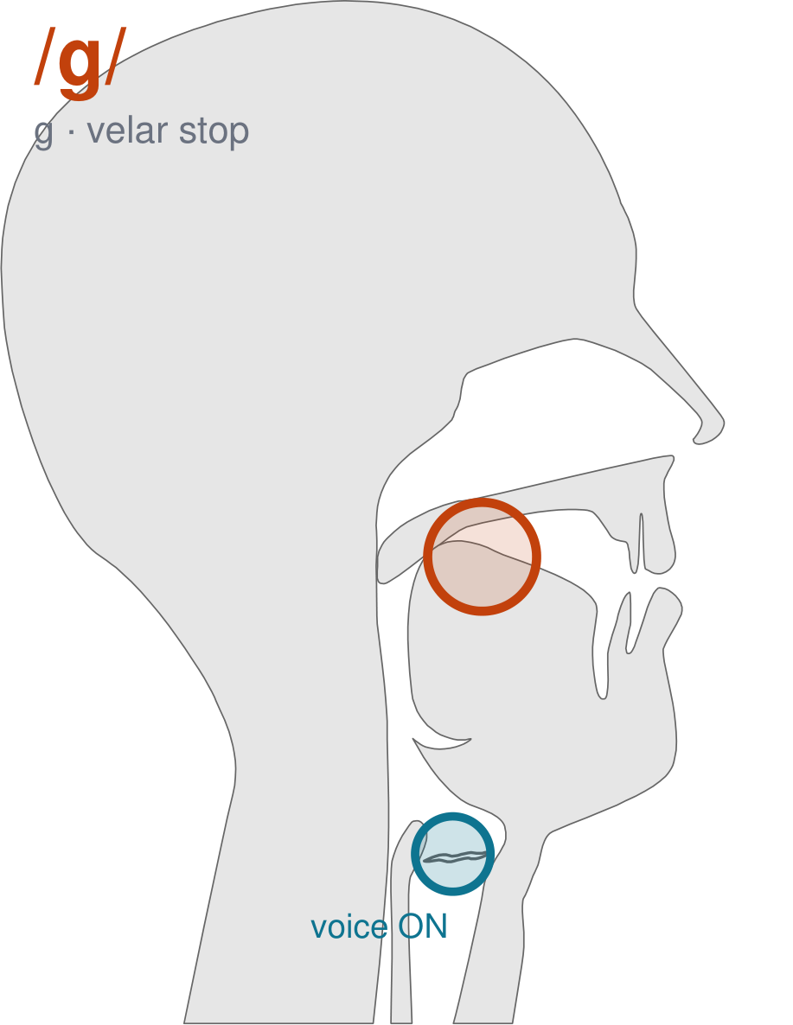
/g/
written g
Back of the tongue up to the back of the roof, same as /k/. Voice ON — /g/.
CHECK: Hand on your throat: /g/ buzzes, /k/ does not.
Notes:
SAY: We have a new sound today. It is written g. Before we read it, we are going to make it.
SAY: Watch my mouth. Do not say anything yet — just watch.
DO: Make the sound three times, slowly, exaggerated. Say nothing else. Let them watch your velar position.
SAY: What did you notice about my mouth?
NOTE: Take two or three answers. Steer toward the moving part — lips, tongue, teeth, air, voice. Do not correct wrong noticing; ask another child.
SAY: Back of the tongue up to the back of the roof, same as /k/. Voice ON — /g/.
SAY: Now you check it on yourself. Hand on your throat: /g/ buzzes, /k/ does not.
DO: Every child does the check. Walk the room. You are looking for the check being DONE, not for the sound being perfect yet.
SAY: Say it with me. /g/ … /g/ … /g/.
NOTE: Individual turns from four or five children, chosen so you hear the ones you are worried about. Give feedback on the MOUTH, not on the sound: 'your teeth were not on your lip' beats 'that was not quite right.'
NOTE: Watch for: /k/.
NOTE: This sound does not exist in Arabic. For those children it is a new physical skill, not a reminder. Expect it to take days, and do not let the column start until the mouth can make it.
SAY: These letters you already know the sound of: b, k, f, j. Say each one as I point.
NOTE: Naming, not teaching — these sounds exist in the children's home languages. If one of them is genuinely shaky for a child, that is a warm-up item tomorrow, not a five-minute detour now.

Slide 3
bad ban band bat
cab cad Cal cat
can gab gad gag
Notes:
The slide starts blank. One click per row.
SAY: Down the first column. My pointer, your voice.
SAY: Now across the rows.
NOTE: down a column can be recited from memory; across cannot. A child who was strong going down and falls apart going across was reciting. That is what this step is for — the same reason a Qaida is drilled down, then across, then random.
SAY: Now I am going to jump around. Watch the pointer.
NOTE: anything missed here goes on tomorrow's warm-up.

Slide 4
gal gas fad lab
nab fan Jan lad
nag fat jab lag
Notes:
The slide starts blank. One click per row.
SAY: Down the first column. My pointer, your voice.
SAY: Now across the rows.
NOTE: down a column can be recited from memory; across cannot. A child who was strong going down and falls apart going across was reciting. That is what this step is for — the same reason a Qaida is drilled down, then across, then random.
SAY: Now I am going to jump around. Watch the pointer.
NOTE: anything missed here goes on tomorrow's warm-up.

Slide 5
Nat Jag
Notes:
The slide starts blank. One click per row.
SAY: Down the first column. My pointer, your voice.
SAY: Now across the rows.
NOTE: down a column can be recited from memory; across cannot. A child who was strong going down and falls apart going across was reciting. That is what this step is for — the same reason a Qaida is drilled down, then across, then random.
SAY: Now I am going to jump around. Watch the pointer.
NOTE: anything missed here goes on tomorrow's warm-up.

Slide 6
lag
Nat
Jag
Notes:
The slide starts blank. Click ONE word per child as they come to you — the queue should not be able to rehearse the next one.
SAY: Before you go, three words, on your own.
NOTE: one child at a time as they line up. Mark 3, 2, or fewer. Two or fewer starts tomorrow's warm-up group. That is the whole reason for recording it — do not skip it, and do not make it public.

