Slide 1
Consonants p, r, t, v, w, y, z; final k
Alpha-Phonics Lesson 9 · p.11
Notes:
Grade K, day 15 of 184. 29.9 minutes.
Segments today: WARM-UP, SOUND, BUILD, COLUMN, SHOW ME, DICTATION, CLOSE
The talk on every slide is in these notes. SAY lines are read as written — they are the routines, and a routine whose wording drifts is one the children have to re-learn. NOTE lines are for you only.

Slide 2
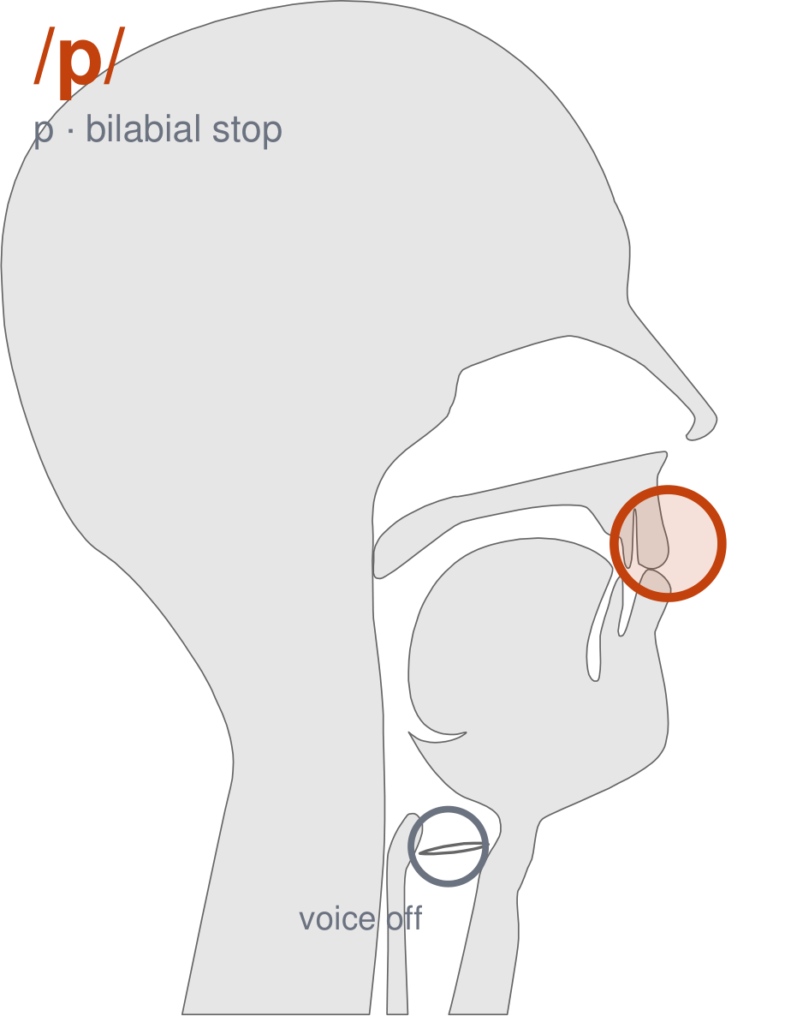
/p/
written p
Put your lips together. Hold the air behind them. Now pop them open — /p/. It is a quiet sound. Your voice stays off.
CHECK: Hold your hand in front of your mouth. You should feel a little puff of air hit it. Now put your other hand on your throat — it should stay still.
Notes:
SAY: We have a new sound today. It is written p. Before we read it, we are going to make it.
SAY: Watch my mouth. Do not say anything yet — just watch.
DO: Make the sound three times, slowly, exaggerated. Say nothing else. Let them watch your bilabial position.
SAY: What did you notice about my mouth?
NOTE: Take two or three answers. Steer toward the moving part — lips, tongue, teeth, air, voice. Do not correct wrong noticing; ask another child.
SAY: Put your lips together. Hold the air behind them. Now pop them open — /p/. It is a quiet sound. Your voice stays off.
SAY: Now you check it on yourself. Hold your hand in front of your mouth. You should feel a little puff of air hit it. Now put your other hand on your throat — it should stay still.
DO: Every child does the check. Walk the room. You are looking for the check being DONE, not for the sound being perfect yet.
SAY: Say it with me. /p/ … /p/ … /p/.
NOTE: Individual turns from four or five children, chosen so you hear the ones you are worried about. Give feedback on the MOUTH, not on the sound: 'your teeth were not on your lip' beats 'that was not quite right.'
NOTE: Watch for: Children swap /p/ and /b/. The lips do the same thing; only the voice differs.
NOTE: This sound does not exist in Somali, Arabic. For those children it is a new physical skill, not a reminder. Expect it to take days, and do not let the column start until the mouth can make it.
SAY: One more sound you will see today: /r/, written r. Curl your tongue tip up and back, and do NOT let it touch anything. Round your lips a little. Voice on — rrrr.
NOTE: Quick introduction only — /r/ gets its full lesson in a day or two. Today the children just need it in the mouth before they meet it in the column.
SAY: One more sound you will see today: /v/, written v. Top teeth on your bottom lip, exactly like /f/. Turn your voice ON — vvvvv. Your lip will tickle.
NOTE: Quick introduction only — /v/ gets its full lesson in a day or two. Today the children just need it in the mouth before they meet it in the column.
SAY: One more sound you will see today: /z/, written z. Exactly the same mouth as /s/. Voice ON — zzzzz, like a bee.
NOTE: Quick introduction only — /z/ gets its full lesson in a day or two. Today the children just need it in the mouth before they meet it in the column.
SAY: These letters you already know the sound of: y. Say each one as I point.
NOTE: Naming, not teaching — these sounds exist in the children's home languages. If one of them is genuinely shaky for a child, that is a warm-up item tomorrow, not a five-minute detour now.

Slide 3
pad pal Pam pan
pat rag ram ran
rap rat tab Tad
Notes:
The slide starts blank. One click per row.
SAY: Down the first column. My pointer, your voice.
SAY: Now across the rows.
NOTE: down a column can be recited from memory; across cannot. A child who was strong going down and falls apart going across was reciting. That is what this step is for — the same reason a Qaida is drilled down, then across, then random.
SAY: Now I am going to jump around. Watch the pointer.
NOTE: anything missed here goes on tomorrow's warm-up.

Slide 4
tag tan tap tax
Val wag yak van
wax yam vat yap
Notes:
The slide starts blank. One click per row.
SAY: Down the first column. My pointer, your voice.
SAY: Now across the rows.
NOTE: down a column can be recited from memory; across cannot. A child who was strong going down and falls apart going across was reciting. That is what this step is for — the same reason a Qaida is drilled down, then across, then random.
SAY: Now I am going to jump around. Watch the pointer.
NOTE: anything missed here goes on tomorrow's warm-up.

Slide 5
yam
vat
yap
Notes:
The slide starts blank. Click ONE word per child as they come to you — the queue should not be able to rehearse the next one.
SAY: Before you go, three words, on your own.
NOTE: one child at a time as they line up. Mark 3, 2, or fewer. Two or fewer starts tomorrow's warm-up group. That is the whole reason for recording it — do not skip it, and do not make it public.

