Slide 1
Short i words; f as ph
Alpha-Phonics Lesson 19 · p.30–32
Notes:
Grade K, day 45 of 184. 26.9 minutes.
Segments today: WARM-UP, SOUND, BUILD, COLUMN, SHOW ME, DICTATION, CLOSE
The talk on every slide is in these notes. SAY lines are read as written — they are the routines, and a routine whose wording drifts is one the children have to re-learn. NOTE lines are for you only.

Slide 2
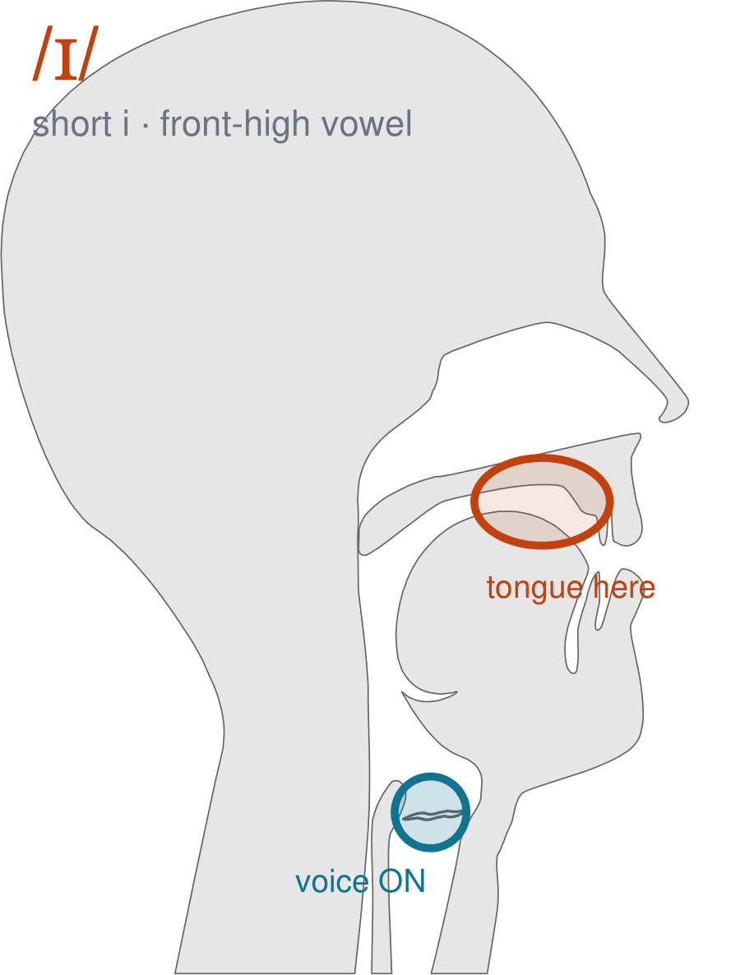
/ɪ/
written short i
Mouth barely open. Lips spread. Tongue high and forward, but relaxed — /i/, as in 'sit'.
CHECK: Say 'bed' then 'bid': the jaw comes up again, and it is the smallest opening of the three.
Notes:
SAY: We have a new sound today. It is the sound we call short i. Before we read it, we are going to make it.
SAY: Watch my mouth. Do not say anything yet — just watch.
DO: Make the sound three times, slowly, exaggerated. Say nothing else. Let them watch your front high position.
SAY: What did you notice about my mouth?
NOTE: Take two or three answers. Steer toward the moving part — lips, tongue, teeth, air, voice. Do not correct wrong noticing; ask another child.
SAY: Mouth barely open. Lips spread. Tongue high and forward, but relaxed — /i/, as in 'sit'.
SAY: Now you check it on yourself. Say 'bed' then 'bid': the jaw comes up again, and it is the smallest opening of the three.
DO: Every child does the check. Walk the room. You are looking for the check being DONE, not for the sound being perfect yet.
SAY: Say it with me. /ɪ/ … /ɪ/ … /ɪ/.
NOTE: Individual turns from four or five children, chosen so you hear the ones you are worried about. Give feedback on the MOUTH, not on the sound: 'your teeth were not on your lip' beats 'that was not quite right.'
NOTE: Watch for: The long ee of 'seat'. Arabic and Somali have the long one, not this short relaxed one, so 'sit' comes out as 'seat'.
NOTE: This sound does not exist in Arabic, Somali, Urdu. For those children it is a new physical skill, not a reminder. Expect it to take days, and do not let the column start until the mouth can make it.

Slide 3
id if bib Dick
bid big fib did
miff dig kick hid
Notes:
The slide starts blank. One click per row.
SAY: Down the first column. My pointer, your voice.
SAY: Now across the rows.
NOTE: down a column can be recited from memory; across cannot. A child who was strong going down and falls apart going across was reciting. That is what this step is for — the same reason a Qaida is drilled down, then across, then random.
SAY: Now I am going to jump around. Watch the pointer.
NOTE: anything missed here goes on tomorrow's warm-up.

Slide 4
fig rib lick kid
lid Nick mid pick
rid quick Sid Rick
Notes:
The slide starts blank. One click per row.
SAY: Down the first column. My pointer, your voice.
SAY: Now across the rows.
NOTE: down a column can be recited from memory; across cannot. A child who was strong going down and falls apart going across was reciting. That is what this step is for — the same reason a Qaida is drilled down, then across, then random.
SAY: Now I am going to jump around. Watch the pointer.
NOTE: anything missed here goes on tomorrow's warm-up.

Slide 5
sick tick wick ill
Bill dill fill gill
hill Jill mill pill
Notes:
The slide starts blank. One click per row.
SAY: Down the first column. My pointer, your voice.
SAY: Now across the rows.
NOTE: down a column can be recited from memory; across cannot. A child who was strong going down and falls apart going across was reciting. That is what this step is for — the same reason a Qaida is drilled down, then across, then random.
SAY: Now I am going to jump around. Watch the pointer.
NOTE: anything missed here goes on tomorrow's warm-up.

Slide 6
quill rill sill till
will dim him Jim
Kim Tim bin fin
Notes:
The slide starts blank. One click per row.
SAY: Down the first column. My pointer, your voice.
SAY: Now across the rows.
NOTE: down a column can be recited from memory; across cannot. A child who was strong going down and falls apart going across was reciting. That is what this step is for — the same reason a Qaida is drilled down, then across, then random.
SAY: Now I am going to jump around. Watch the pointer.
NOTE: anything missed here goes on tomorrow's warm-up.

Slide 7
kin tin Continued dip
his hip lip hiss
kiss tip it bit
Notes:
The slide starts blank. One click per row.
SAY: Down the first column. My pointer, your voice.
SAY: Now across the rows.
NOTE: down a column can be recited from memory; across cannot. A child who was strong going down and falls apart going across was reciting. That is what this step is for — the same reason a Qaida is drilled down, then across, then random.
SAY: Now I am going to jump around. Watch the pointer.
NOTE: anything missed here goes on tomorrow's warm-up.

Slide 8
wit
Phil
Philip
Notes:
The slide starts blank. Click ONE word per child as they come to you — the queue should not be able to rehearse the next one.
SAY: Before you go, three words, on your own.
NOTE: one child at a time as they line up. Mark 3, 2, or fewer. Two or fewer starts tomorrow's warm-up group. That is the whole reason for recording it — do not skip it, and do not make it public.

