Slide 1
sh as ti, ssi, ci, ce, sci, xi, su, ssu; zh as si, su; ch as tu, ti
Alpha-Phonics Lesson 121 · p.128–129
Notes:
Grade K, day 175 of 184. 30.4 minutes.
Segments today: WARM-UP, SOUND, BUILD, COLUMN, SHOW ME, DICTATION, SENTENCES, CLOSE
The talk on every slide is in these notes. SAY lines are read as written — they are the routines, and a routine whose wording drifts is one the children have to re-learn. NOTE lines are for you only.

Slide 2
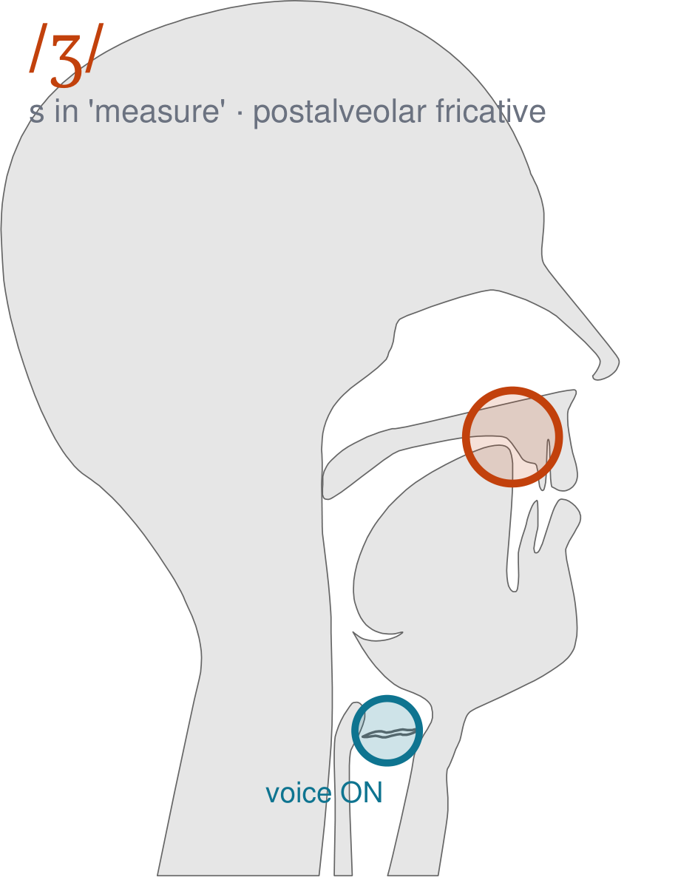
/ʒ/
written s in 'measure'
The same mouth as sh, with your voice ON. It is the sound in the middle of 'measure' and 'treasure'.
CHECK: Hand on your throat: this one buzzes, sh does not.
Notes:
SAY: We have a new sound today. It is written s in 'measure'. Before we read it, we are going to make it.
SAY: Watch my mouth. Do not say anything yet — just watch.
DO: Make the sound three times, slowly, exaggerated. Say nothing else. Let them watch your postalveolar position.
SAY: What did you notice about my mouth?
NOTE: Take two or three answers. Steer toward the moving part — lips, tongue, teeth, air, voice. Do not correct wrong noticing; ask another child.
SAY: The same mouth as sh, with your voice ON. It is the sound in the middle of 'measure' and 'treasure'.
SAY: Now you check it on yourself. Hand on your throat: this one buzzes, sh does not.
DO: Every child does the check. Walk the room. You are looking for the check being DONE, not for the sound being perfect yet.
SAY: Say it with me. /ʒ/ … /ʒ/ … /ʒ/.
NOTE: Individual turns from four or five children, chosen so you hear the ones you are worried about. Give feedback on the MOUTH, not on the sound: 'your teeth were not on your lip' beats 'that was not quite right.'
NOTE: Watch for: sh, and /dʒ/ as in 'jam'.
NOTE: This sound does not exist in Somali, Arabic, Urdu. For those children it is a new physical skill, not a reminder. Expect it to take days, and do not let the column start until the mouth can make it.

Slide 3
pharmacist emphasis emphatic ssi
nation patient fission racial
station patience mission facial
Notes:
The slide starts blank. One click per row.
SAY: Down the first column. My pointer, your voice.
SAY: Now across the rows.
NOTE: down a column can be recited from memory; across cannot. A child who was strong going down and falls apart going across was reciting. That is what this step is for — the same reason a Qaida is drilled down, then across, then random.
SAY: Now I am going to jump around. Watch the pointer.
NOTE: anything missed here goes on tomorrow's warm-up.

Slide 4
ration action admission special
lotion fraction session crucial
motion traction musician notion
Notes:
The slide starts blank. One click per row.
SAY: Down the first column. My pointer, your voice.
SAY: Now across the rows.
NOTE: down a column can be recited from memory; across cannot. A child who was strong going down and falls apart going across was reciting. That is what this step is for — the same reason a Qaida is drilled down, then across, then random.
SAY: Now I am going to jump around. Watch the pointer.
NOTE: anything missed here goes on tomorrow's warm-up.

Slide 5
ocean atrocious obnoxious sure
Issue ferocious Insure tissue
conscious assure conscience fissure
Notes:
The slide starts blank. One click per row.
SAY: Down the first column. My pointer, your voice.
SAY: Now across the rows.
NOTE: down a column can be recited from memory; across cannot. A child who was strong going down and falls apart going across was reciting. That is what this step is for — the same reason a Qaida is drilled down, then across, then random.
SAY: Now I am going to jump around. Watch the pointer.
NOTE: anything missed here goes on tomorrow's warm-up.

Slide 6
Continued fusion measure capture
question confusion pleasure fracture
illusion treasure gesture intrusion
Notes:
The slide starts blank. One click per row.
SAY: Down the first column. My pointer, your voice.
SAY: Now across the rows.
NOTE: down a column can be recited from memory; across cannot. A child who was strong going down and falls apart going across was reciting. That is what this step is for — the same reason a Qaida is drilled down, then across, then random.
SAY: Now I am going to jump around. Watch the pointer.
NOTE: anything missed here goes on tomorrow's warm-up.

Slide 7
leisure picture suggestion tissues
Notes:
The slide starts blank. One click per row.
SAY: Down the first column. My pointer, your voice.
SAY: Now across the rows.
NOTE: down a column can be recited from memory; across cannot. A child who was strong going down and falls apart going across was reciting. That is what this step is for — the same reason a Qaida is drilled down, then across, then random.
SAY: Now I am going to jump around. Watch the pointer.
NOTE: anything missed here goes on tomorrow's warm-up.

Slide 8
The ocean can be ferocious.
Notes:
The slide starts blank — click when the class is silent and looking, not before.
SAY: Read it in your head first. Put your finger up when you have it.
NOTE: wait for most fingers before calling on anyone. Silent-first is what makes this reading rather than listening.
SAY: Together: The ocean can be ferocious.
NOTE: then two or three individual readers — never round the class in seating order.

Slide 9
Ralph is a musician and won a special prize at the fair.
Notes:
The slide starts blank — click when the class is silent and looking, not before.
SAY: Read it in your head first. Put your finger up when you have it.
NOTE: wait for most fingers before calling on anyone. Silent-first is what makes this reading rather than listening.
SAY: Together: Ralph is a musician and won a special prize at the fair.
NOTE: then two or three individual readers — never round the class in seating order.

Slide 10
Jeff went to the train station to pick up Kate.
Notes:
The slide starts blank — click when the class is silent and looking, not before.
SAY: Read it in your head first. Put your finger up when you have it.
NOTE: wait for most fingers before calling on anyone. Silent-first is what makes this reading rather than listening.
SAY: Together: Jeff went to the train station to pick up Kate.
NOTE: then two or three individual readers — never round the class in seating order.

Slide 11
Did you see Gail's picture on the table?
Notes:
The slide starts blank — click when the class is silent and looking, not before.
SAY: Read it in your head first. Put your finger up when you have it.
NOTE: wait for most fingers before calling on anyone. Silent-first is what makes this reading rather than listening.
SAY: Together: Did you see Gail's picture on the table?
NOTE: then two or three individual readers — never round the class in seating order.

Slide 12
Betty had a crucial question for the teacher.
Notes:
The slide starts blank — click when the class is silent and looking, not before.
SAY: Read it in your head first. Put your finger up when you have it.
NOTE: wait for most fingers before calling on anyone. Silent-first is what makes this reading rather than listening.
SAY: Together: Betty had a crucial question for the teacher.
NOTE: then two or three individual readers — never round the class in seating order.

Slide 13
"Thank you for being so patient," said Dad.
Notes:
The slide starts blank — click when the class is silent and looking, not before.
SAY: Read it in your head first. Put your finger up when you have it.
NOTE: wait for most fingers before calling on anyone. Silent-first is what makes this reading rather than listening.
SAY: Together: "Thank you for being so patient," said Dad.
NOTE: then two or three individual readers — never round the class in seating order.

Slide 14
picture
suggestion
tissues
Notes:
The slide starts blank. Click ONE word per child as they come to you — the queue should not be able to rehearse the next one.
SAY: Before you go, three words, on your own.
NOTE: one child at a time as they line up. Mark 3, 2, or fewer. Two or fewer starts tomorrow's warm-up group. That is the whole reason for recording it — do not skip it, and do not make it public.

